Slide 1
UWW
Technology Tools, Support, & Solutions
Kirsten Mortimer, Strategic Services Manager, IT Services
Eric Stelter, Technology Solutions Specialist, IT Services

Slide 2

Session Overview
This session approaches IT Services through a professional development lens,
helping you-
Build the skills to navigate and use technology more effectively in your day-to-day work.
Learn where to find key IT resources at UWW, how to access the right support when you need it
How to use LinkedIn Learning to strengthen your technical and professional skill set.
The session includes interactive discussion and Q&A, with a focus on increasing your confidence, self-sufficiency, and ability to continue learning beyond the session.

Slide 3
Understanding Your Needs
Who are you and what are your technology needs?
What skills do you want to grow?
How do you use technology to help others?
What are your pain points, questions, concerns, or problems?

Slide 4
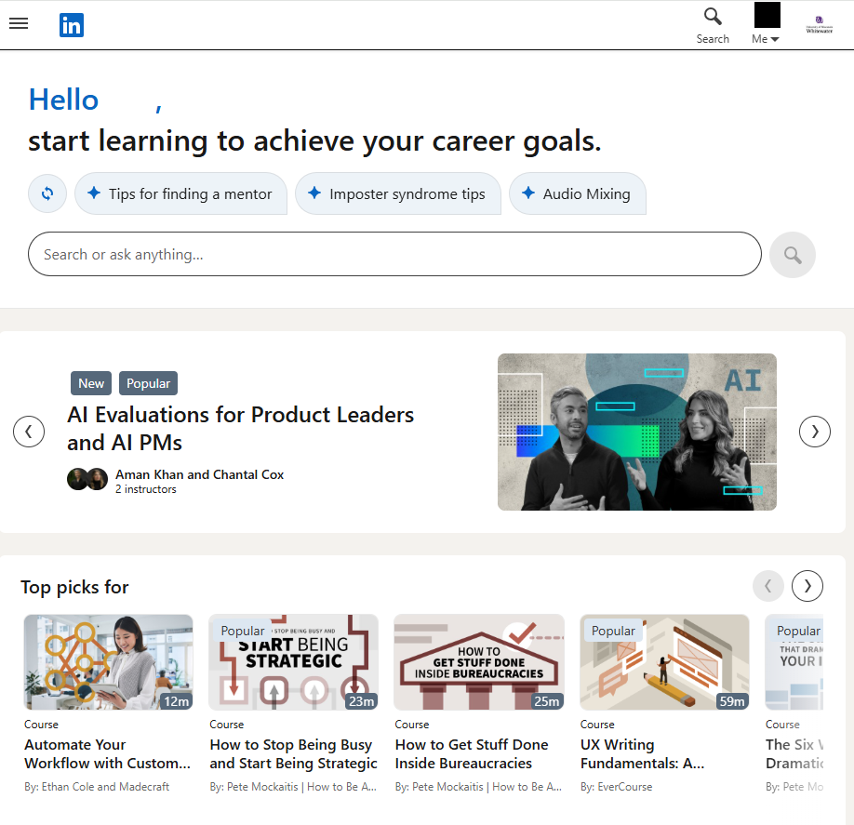
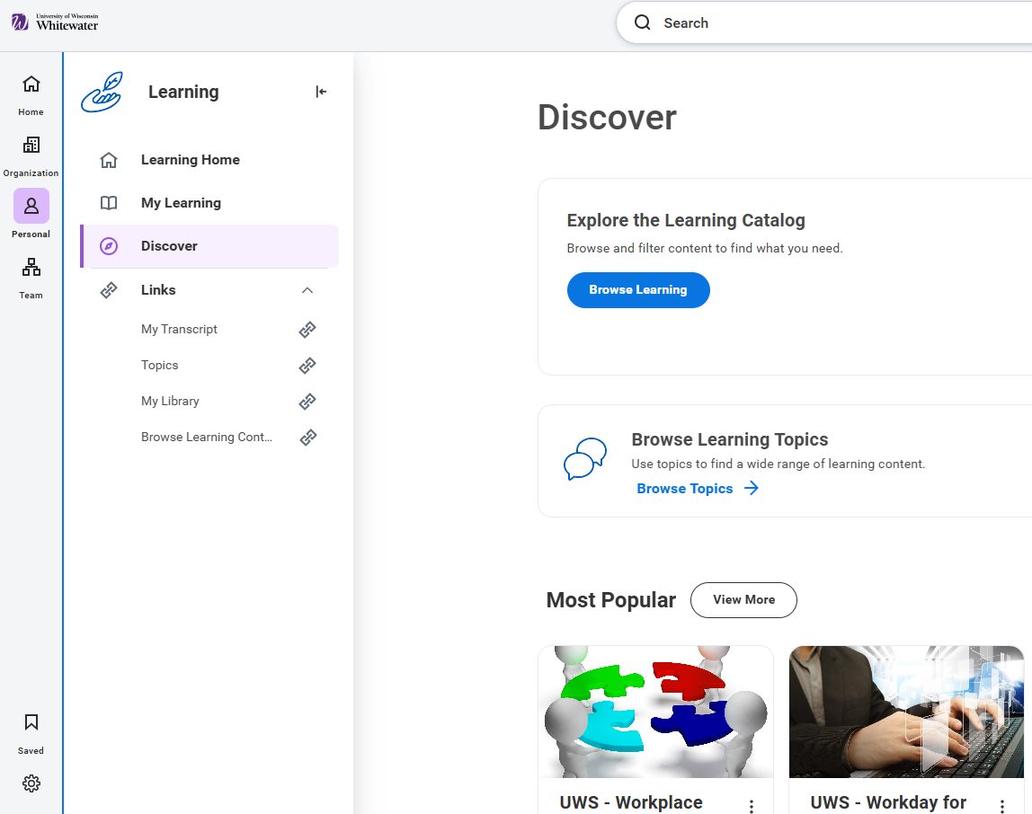
On‑Demand Professional Development
LinkedIn Learning | Workday Learning Catalog

Slide 5
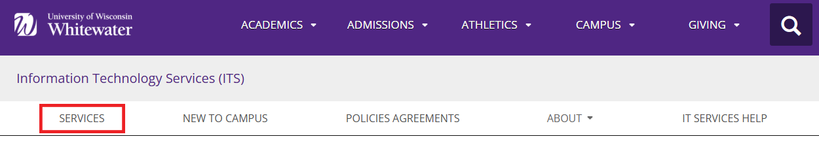
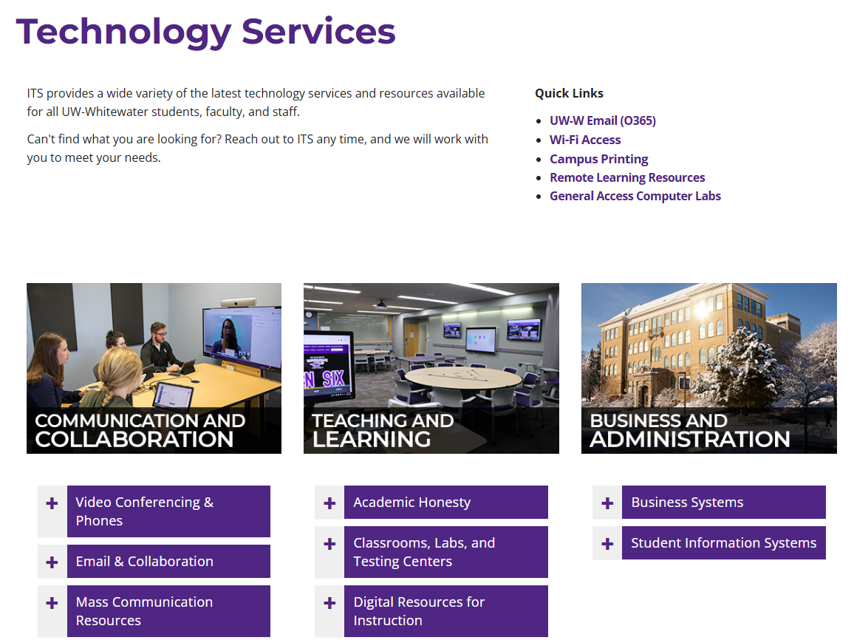
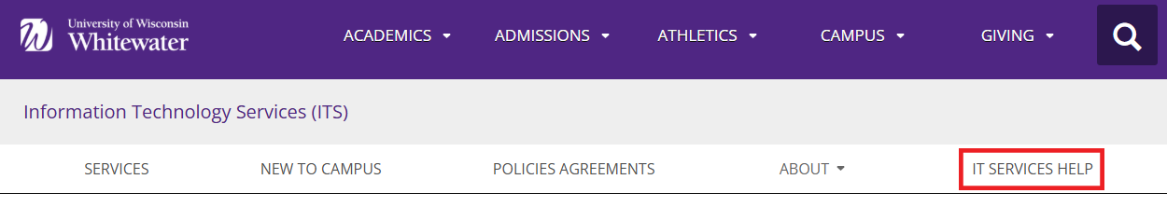
IT Services Overview
Campus-supported technology tools and services
Go to uww.edu
Search “ITS”
Click on “Services”
Working with the Help Desk
Click on “IT Services Help”

Slide 6
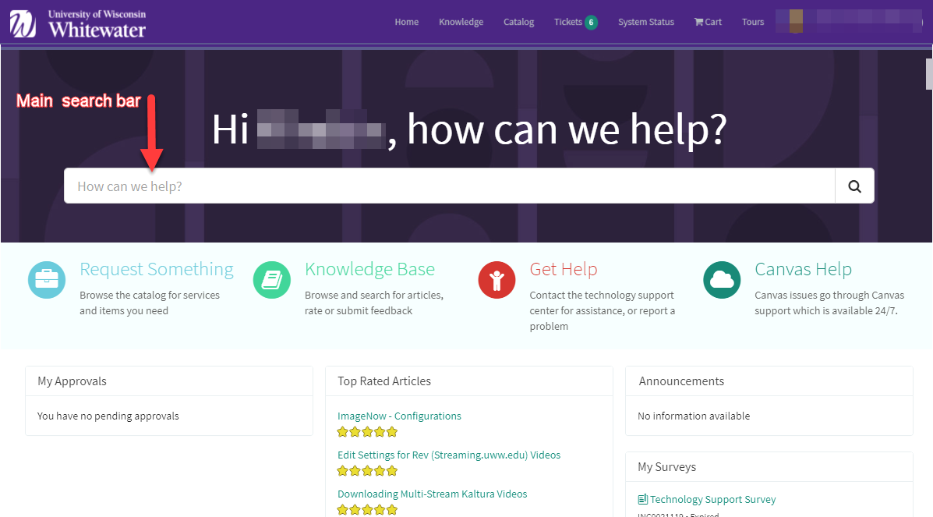
Knowledge Facilitation
IT Services Knowledge Base within ServiceNow
helpdesk.uww.edu

Slide 7
On-Demand Help Resources
ServiceNow (SN): Self-service and on-demand resources for using and troubleshooting technology.
uww.service-now.com/sp/
Search by:
- KB number
- Keyword
- Phrase
Repurposing equipment

Slide 8


Perks for Personal Devices
Office 365
Adobe Creative Cloud
Adobe Express
Antivirus Options

Slide 9
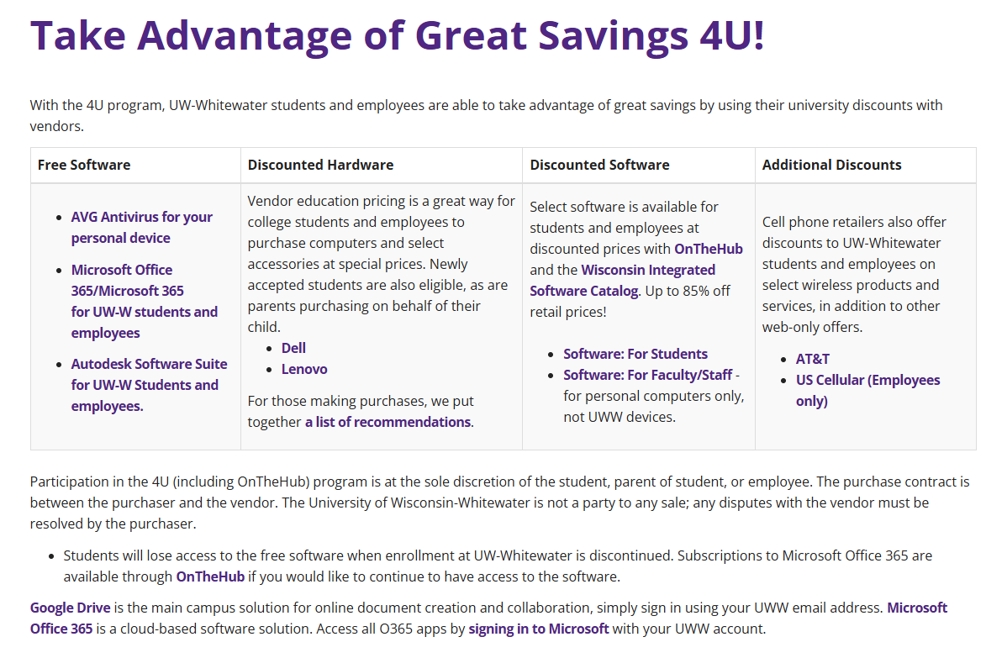
Additional Perks
Discounted hardware, software, and cell service using 4U
4U Program

Slide 10
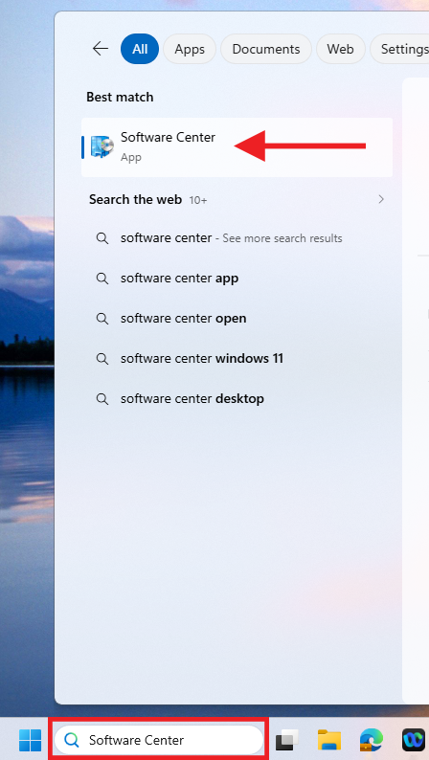
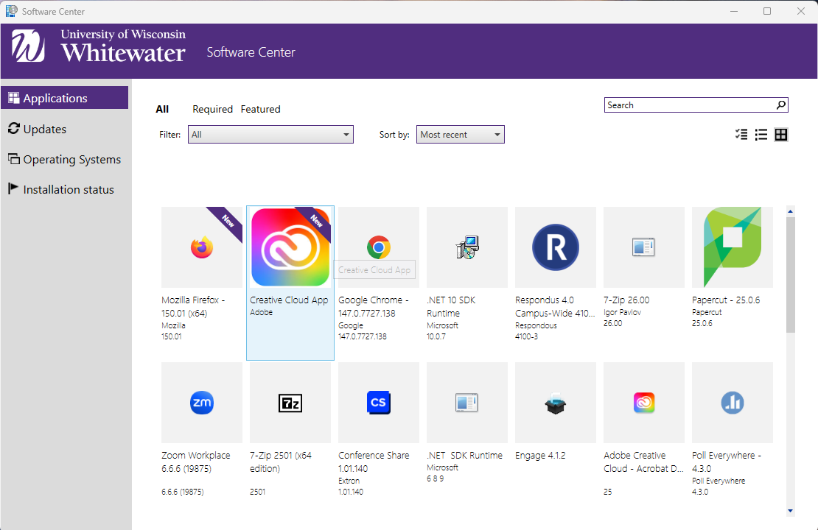
Tips & Tools - Software Center
Search your computer for “Software Center”

Slide 11
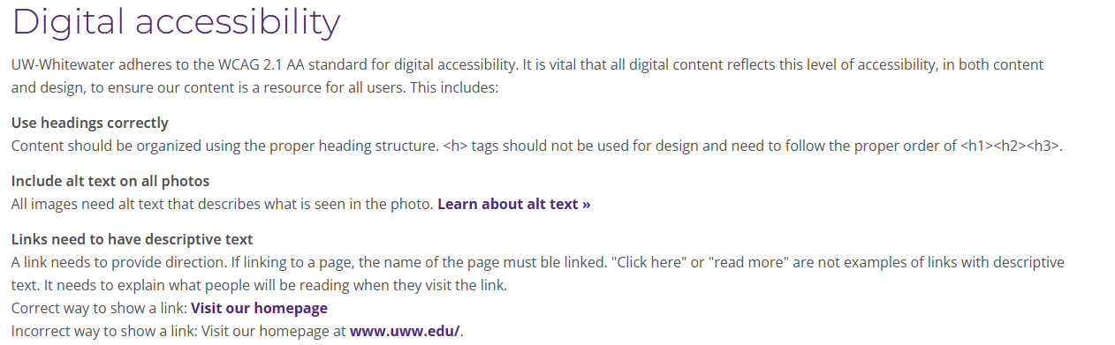
Tips & Tools - Digital Accessibility
Digital standards provide the framework for content creators to ensure digital content is built correctly, using best practices and in accordance with accessibility needs to support the university's mission and the website operating agreement.
Digital Accessibility

Slide 12
Cyber Security
Malware, Ransomware, Phishing - The Help Desk is here to help you!
Contact the Help Desk to report an IT security incident or concern.
IT Security Training & Initiatives
Email sending limits reduce the spread of phishing scams. Contact the Help Desk to create a distribution list.

Slide 13
Additional Information
- Classroom Technology
- Outlook - Saving time with tips and tricks
- T:Drive Access
- Offboarding Tips
- Technology Purchasing
- Onboarding Tips
- Canvas

Slide 14
Questions?

