Slide 1
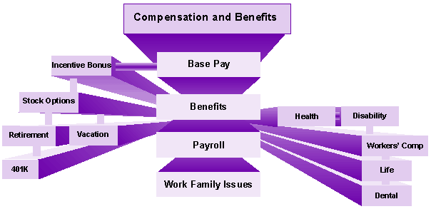
Total Rewards/Total Compensation
Direct Compensation = Your base salary or hourly rate. This may include overloads, stipends, etc.
Indirect Compensation = (Fringe Cost/Benefits) consist of all compensation that is not paid directly to an employee and is calculated in addition to base salary, incentive pay, etc.,
Presented By: Steve Marshall
Director of Human Resources - UW Whitewater

Slide 2

Our goal today is to get high level view of our indirect compensation offerings. This will help you plan for the future and make more informed decisions.

Slide 3

Dental Insurance
Health Insurance
Life Insurance
Vacation
Vision Insurance
Let’s talk about Indirect Compensation………

Slide 4

Paid Leave
Vacation
Sick Leave
Personal Holiday
Paid Holiday
Notes:
Wisconsin Family And Medical Leave Act
Overview
Family Medical Leave is a benefit available by state law to certain employees. The Family Medical Leave Act (FMLA) provides unpaid leave for an employee's serious health condition, the serious health condition of a parent, child or spouse, or for the birth or adoption of a child. A covered employer has at least 50 permanent employees during at least 6 of the last 12 months. Covered employees have worked for the employer for at least 52 consecutive weeks and for at least 1000 hours in the preceding 52 week period.
What is required of employers?
An employer must permit the employee to take up to 2 weeks of leave for their own serious health condition in a calendar year, up to 2 weeks for the serious health condition of a parent, child or spouse, and up to 6 weeks for the birth or adoption of a child. This leave may be taken as needed in blocks or intermittently as needed by the employee.
During the leave, the employee's health insurance must be continued under the same conditions as prior to leave.
The employee must be allowed to substitute accrued paid or unpaid leave of any other type the employer provides.
When an employee returns from leave, they must be restored to the same position or an equivalent position in all terms and conditions of employment.

Slide 5

Flexible work hours
Telecommute
Keep in mind it is up to the managing unit and unique job specifics that help guide a departments flexibility. Not all positions will have the same options
Notes:
Chat -Other Options?

Slide 6
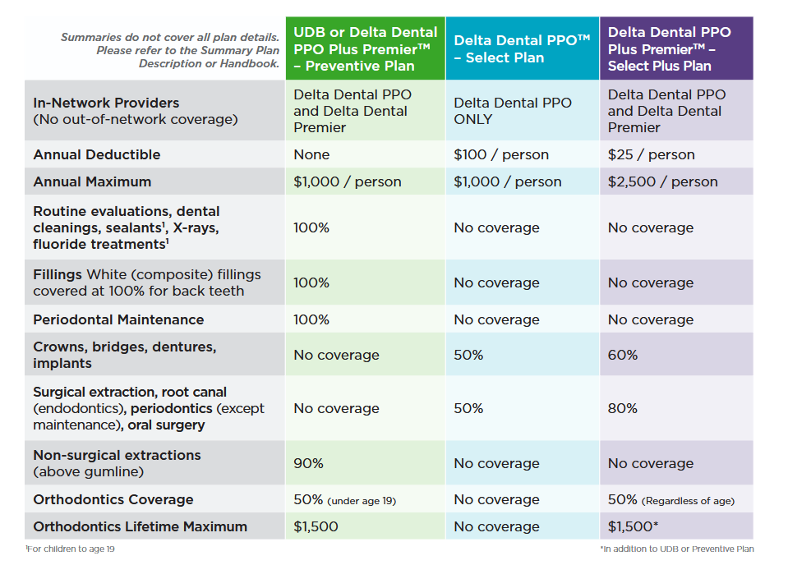
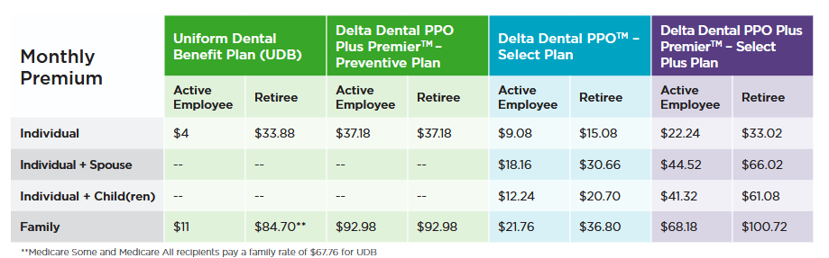
Dental
Insurance

Slide 7
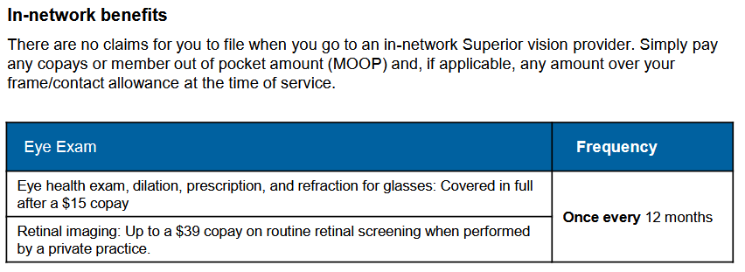

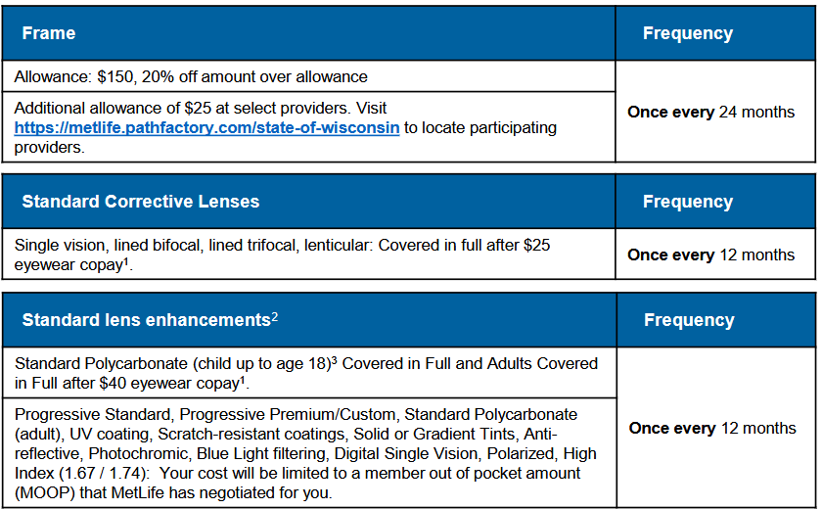
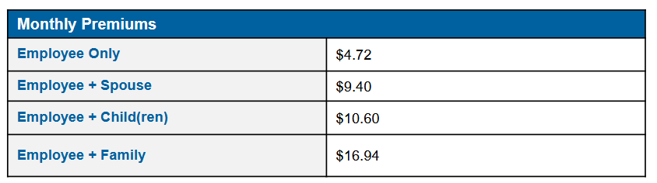
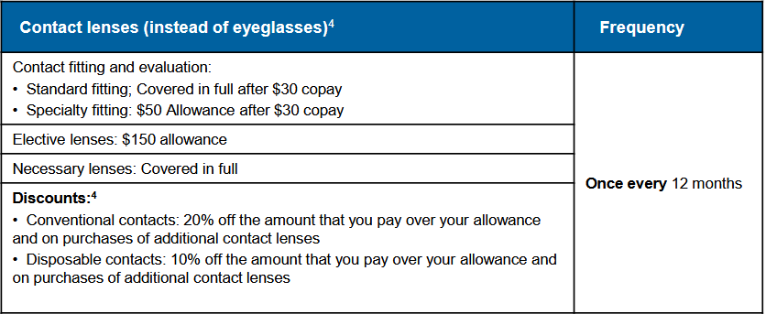
Notes:
5 minute break

Slide 8


Group Rates
Supplemented Insurance
Types of insurance (Term Life, Whole Life)
What happens when an employee leaves employment (continuation/conversion)?
Standard Sequence/Order of Precedence
  Beneficiary form completed
Notes:
Chat-Conversion vs. Continuation
Conversion is usually to Whole life and pricing…..
If you do not have a designation on file, benefits will be paid in the order of “Statutory Standard Sequence” (a Wisconsin State law):
1-Surviving Spouse or Domestic Partner
2-Children (natural or legally adopted)-If one of your children dies before you, that child’s share is divided between the deceased child’s children.
3-Parent(s)
4-Brother(s) and Sister(s)-If one of your siblings dies before you, that sibling’s share is divided between the deceased sibling’s children.
5-Estate

Slide 9
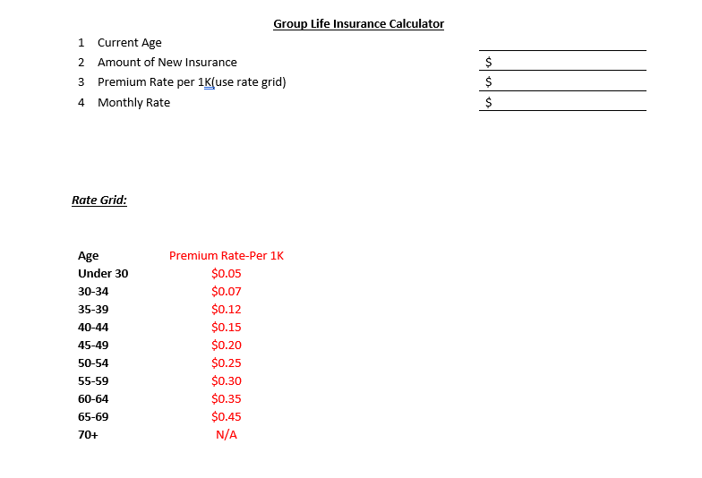
Individual Exercise #1 - Group Life Insurance – Term Insurance
Notes:
Individual exercise

Slide 10
Individual Exercise #1 - Group Life Insurance – Term Insurance
56
200,000.00
200x.30
$60.00 per month
Notes:
Individual exercise

Slide 11
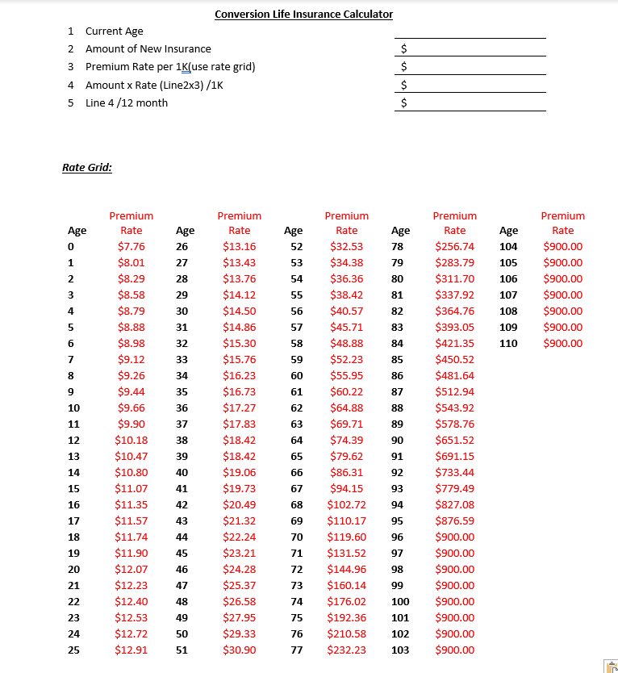
Exercise – Conversion Life Insurance-Whole Life Insurance
Notes:
Individual exercise

Slide 12
Exercise – Conversion Life Insurance-Whole Life Insurance
56
200,000.00
$40.57
200 x 40.57
$8114.00 per yr
$8114/12 months=$676.17 per month
Notes:
At 51 this was $6180 / $515 monthly

Slide 13


Health Insurance Terminology

Slide 14
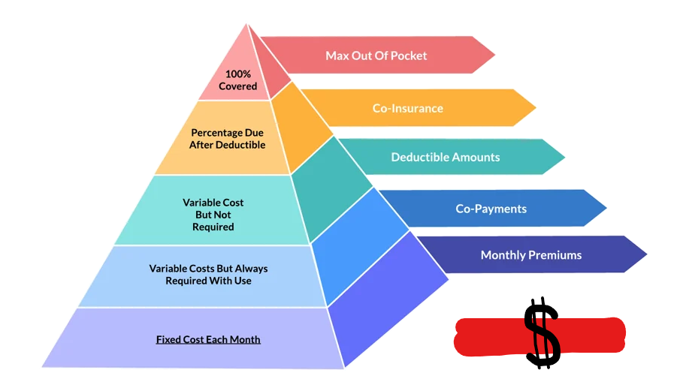
Start at the base of the pyramid. The monthly premiums you pay….

Slide 15
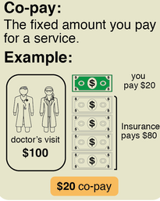
Co-Payments

Slide 16
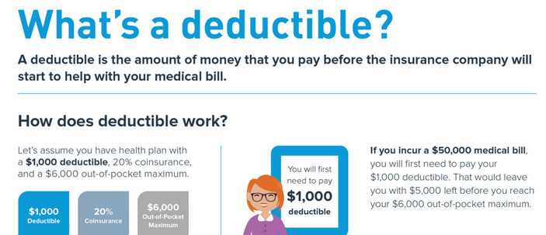
Deductible

Slide 17

Coinsurance

Slide 18
Out Of Pocket Limit(OOPL) / Maximum Out Of Pocket (MOOP)
The aggregate total you will pay out of your pocket in any plan year. Once your limit is met the health insurance company will pay 100% of the costs for covered medical expenses. Co payments may or may not be included in this amount.

Slide 19
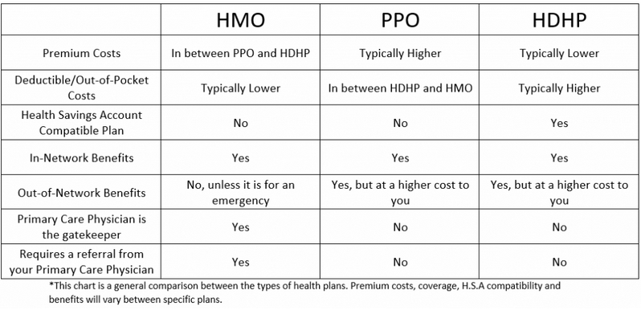
UW Plan reference - Health Plan=HMO / Access Plan=PPO / HDHP=HDHP

Slide 20

Coordination of Benefits

Slide 21

Exercise Your Knowledge!
Health insurance is like a snowflake, no two are exactly the same.

Slide 22
Our Plans for today's discussion. This scenario will be based on a “Family” plan in place.
HDHP
Monthly Premium=$122
Deductible=$3400
Coinsurance=10%
MOOP=$5000
Has HSA- $1704 employer contribution
HMO
Monthly Premium=$329
Deductible=$250 per person / $500 Family
Coinsurance=10%
MOOP=$1250 per person / $2500 family
Did not enroll is FSA
Notes:
Participants bring up scenarios

Slide 23
Health Insurance plan coverage:
Plan year runs from 1-1-26 to 12-31-26
Scenario #1
In February, Steve had a snowmobile accident and breaks his leg. His hospital/surgical visit will cost $50,000. Steve will have five(5) follow up sessions for therapy at $150 each session.
Apply the scenario to each plan, the HMO and HDHP and then discuss these topics at your table. Once finished we will talk about your findings and other scenarios.
Scenario #1 Worksheet
Notes:
Break out – 5 Minutes to work through this scenario

Slide 24
Results for scenario #1
HDHP
Hospital bill
$50,000
Therapy
5 visits @$150= $750.00
Total costs for this event
$50,000 hospital bills + $750 Therapy bill = $50,750. Will pay the first $3,400 for the deductible, then 10% of remaining $47,350 or $4,735. $3400 + $4735 = $8,135. This is greater than the MOOP of $5,000. Will only pay up to the MOOP and all other bills are covered at 100%
Total costs for the year if only event
$5000 MOOP + $1,464 ($122 x 12) in annual premiums = $6,464 - UW establishes an HSA and contributes $1,704 toward a family plan. $6,464 - $1,704= $4,760 in total costs with annual policy premiums
HMO
Hospital bill
$50,000
Therapy
5 visits @$150= $750.00
Total costs for this event
$50,000 hospital bills + $750 Therapy bill = $50,750. $50,750 - $250 per person deductible = $50,500. $50,500 x 10% coinsurance = $5,050. This is greater than the $1250 per person MOOP. Will pay max of $1250 and remaining bills are covered 100%
Total costs for the year if only event
$1250 MOOP + $3948 (329x12) in annual premiums = $5,198 in total costs with annual policy premiums
Notes:
5 minute break

Slide 25

Must have HDHP
HSA balance rolls over
Can be changed anytime
Any balances in account will follow employee if they leave employment
Investment options

Slide 26

FSA may have limited roll over or Grace period
Must plan during Open Enrollment
Interim changes only for life events
Use it or lose it (limited Roll over $)
Notes:
Chat: Roll over or Grace Period offered?

Slide 27
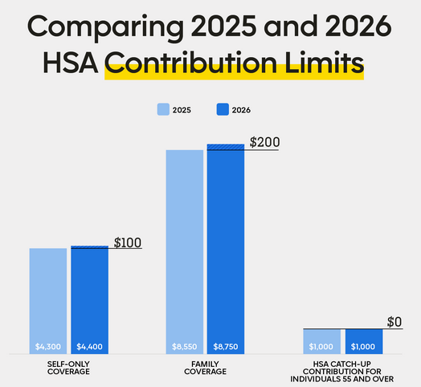
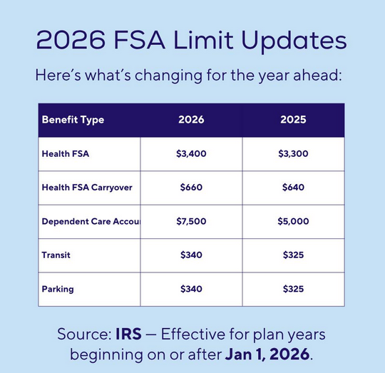

Slide 28

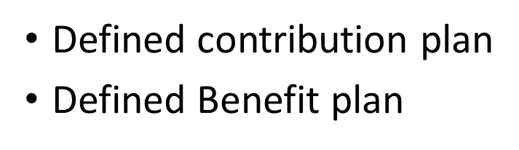
- These are our 403B (SRP) and WDC (457) Plans
- This is the WRS plan (If eligible)

Slide 29


Steve Marshall
marshals@uww.edu
Notes:
Steve- End of Program and thank you!
Lisa- Closing presentation and course end

