Slide 1
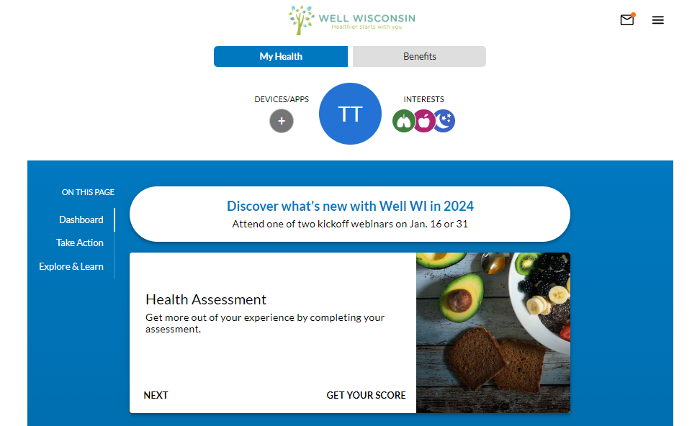
Well Wisconsin
Registering for a screening
Log on to webmdhealth.com/wellwisconsin
Click Benefits

Slide 2
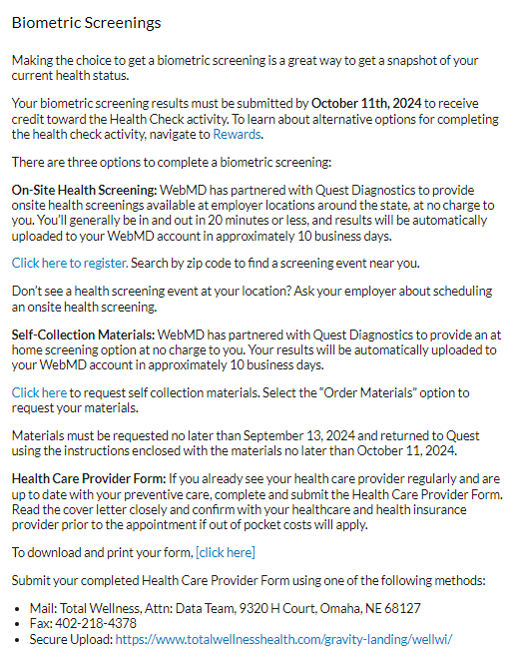
Well Wisconsin
Registering for a screening
Click on Get Started on the Biometric Screening card
Under Biometric Screenings, Click here to register

Slide 3
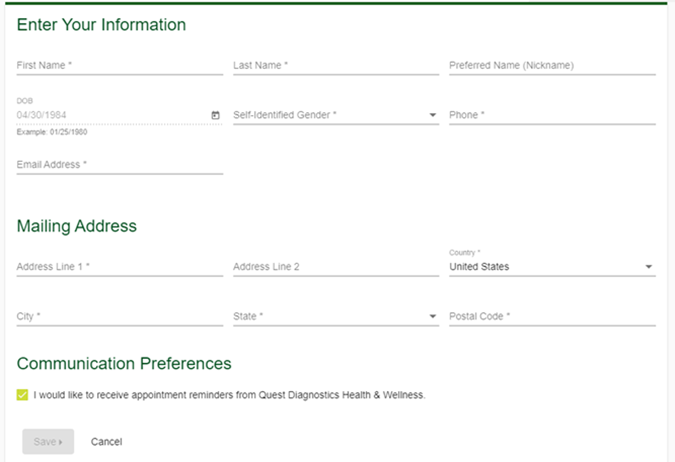
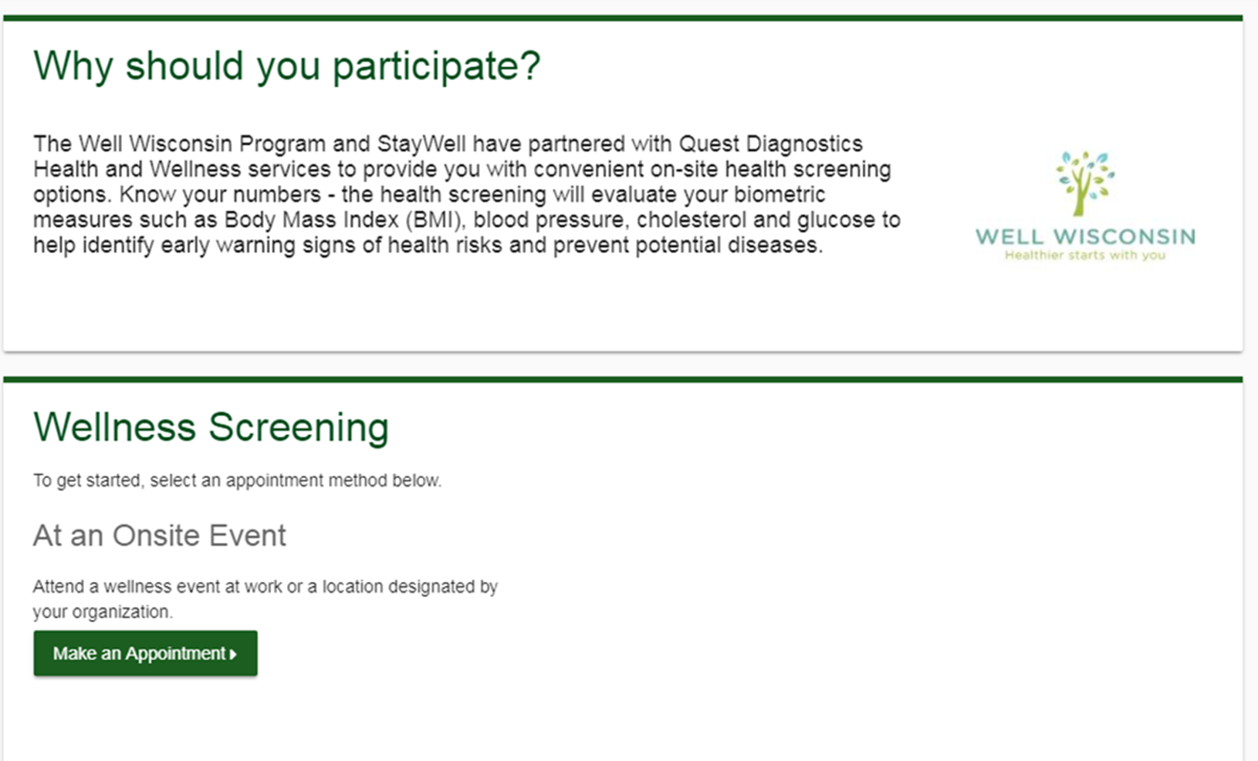
Well Wisconsin
Registering for a biometric screening or self-collection materials
Verify your information, phone number and email address are required
Click Save
To schedule an appointment at an onsite event, click Make an Appointment
To order Self-collection materials, click Order Materials

Slide 4
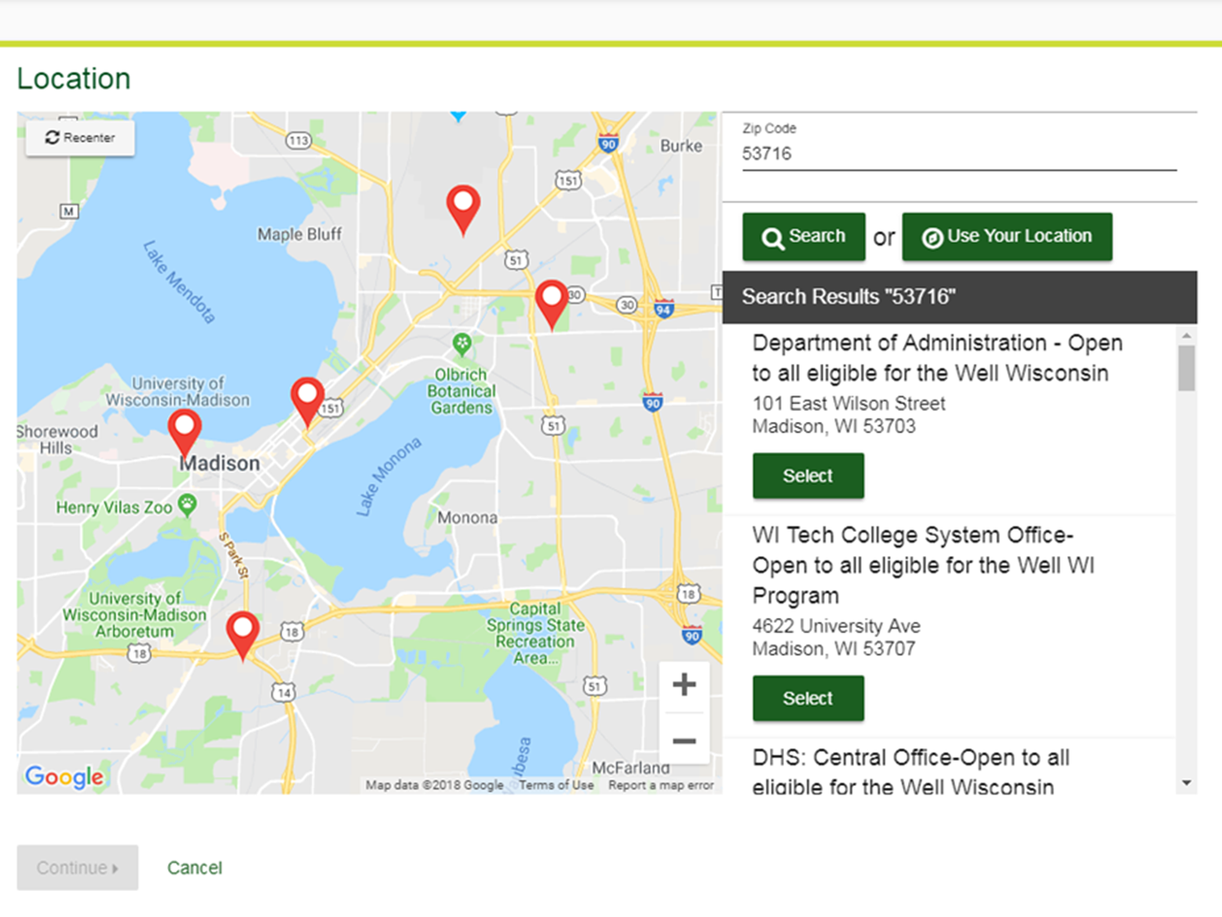
Well Wisconsin
Registering for a biometric screening
Participant’s home zip code will populate
Zip code field can be updated to search for other events
Once the zip code is typed, click Search
You can scroll the Search Results to view all the available locations
Click Continue once you have selected a location

Slide 5
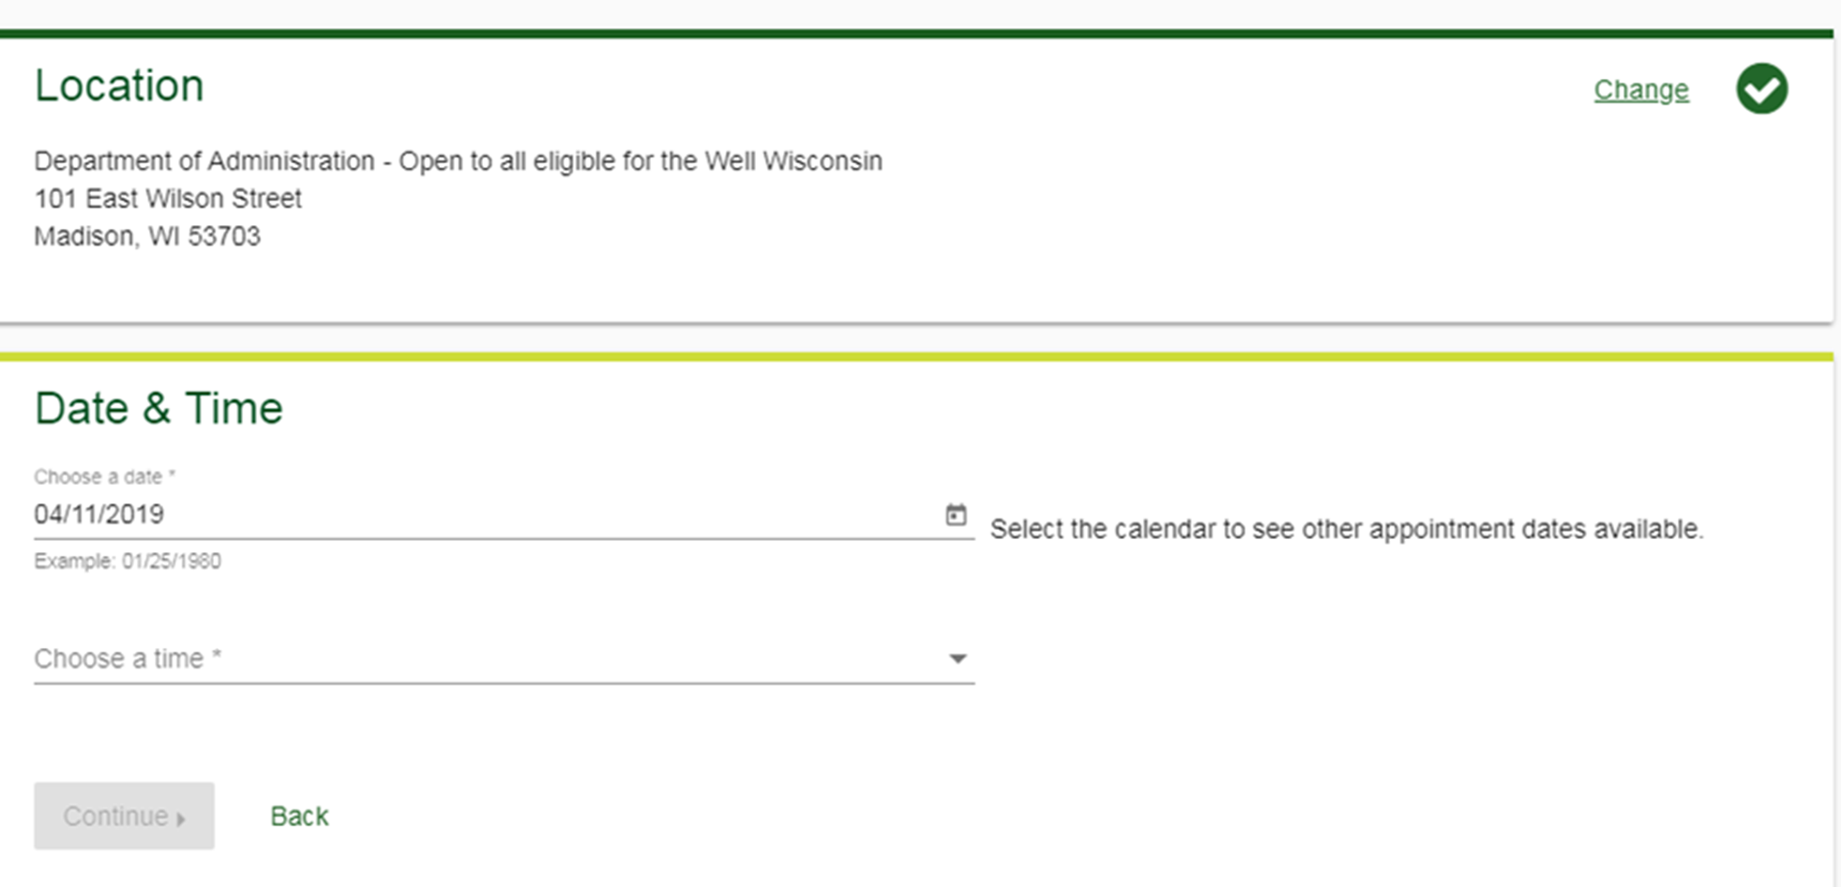
Well Wisconsin
Registering for a biometric screening
Select a date and time
Click Continue
Click Change to select a different location

Slide 6
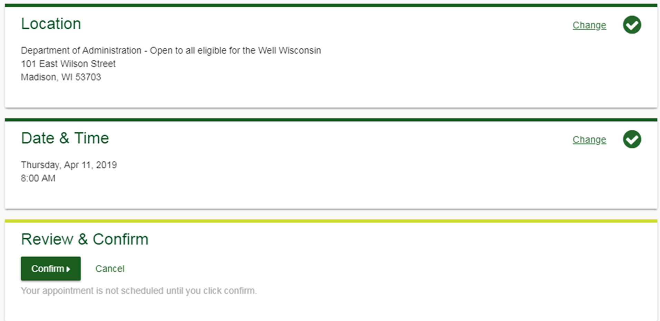
Well Wisconsin
Registering for a biometric screening
Review your appointment details
Click Confirm to schedule your appointment

Slide 7
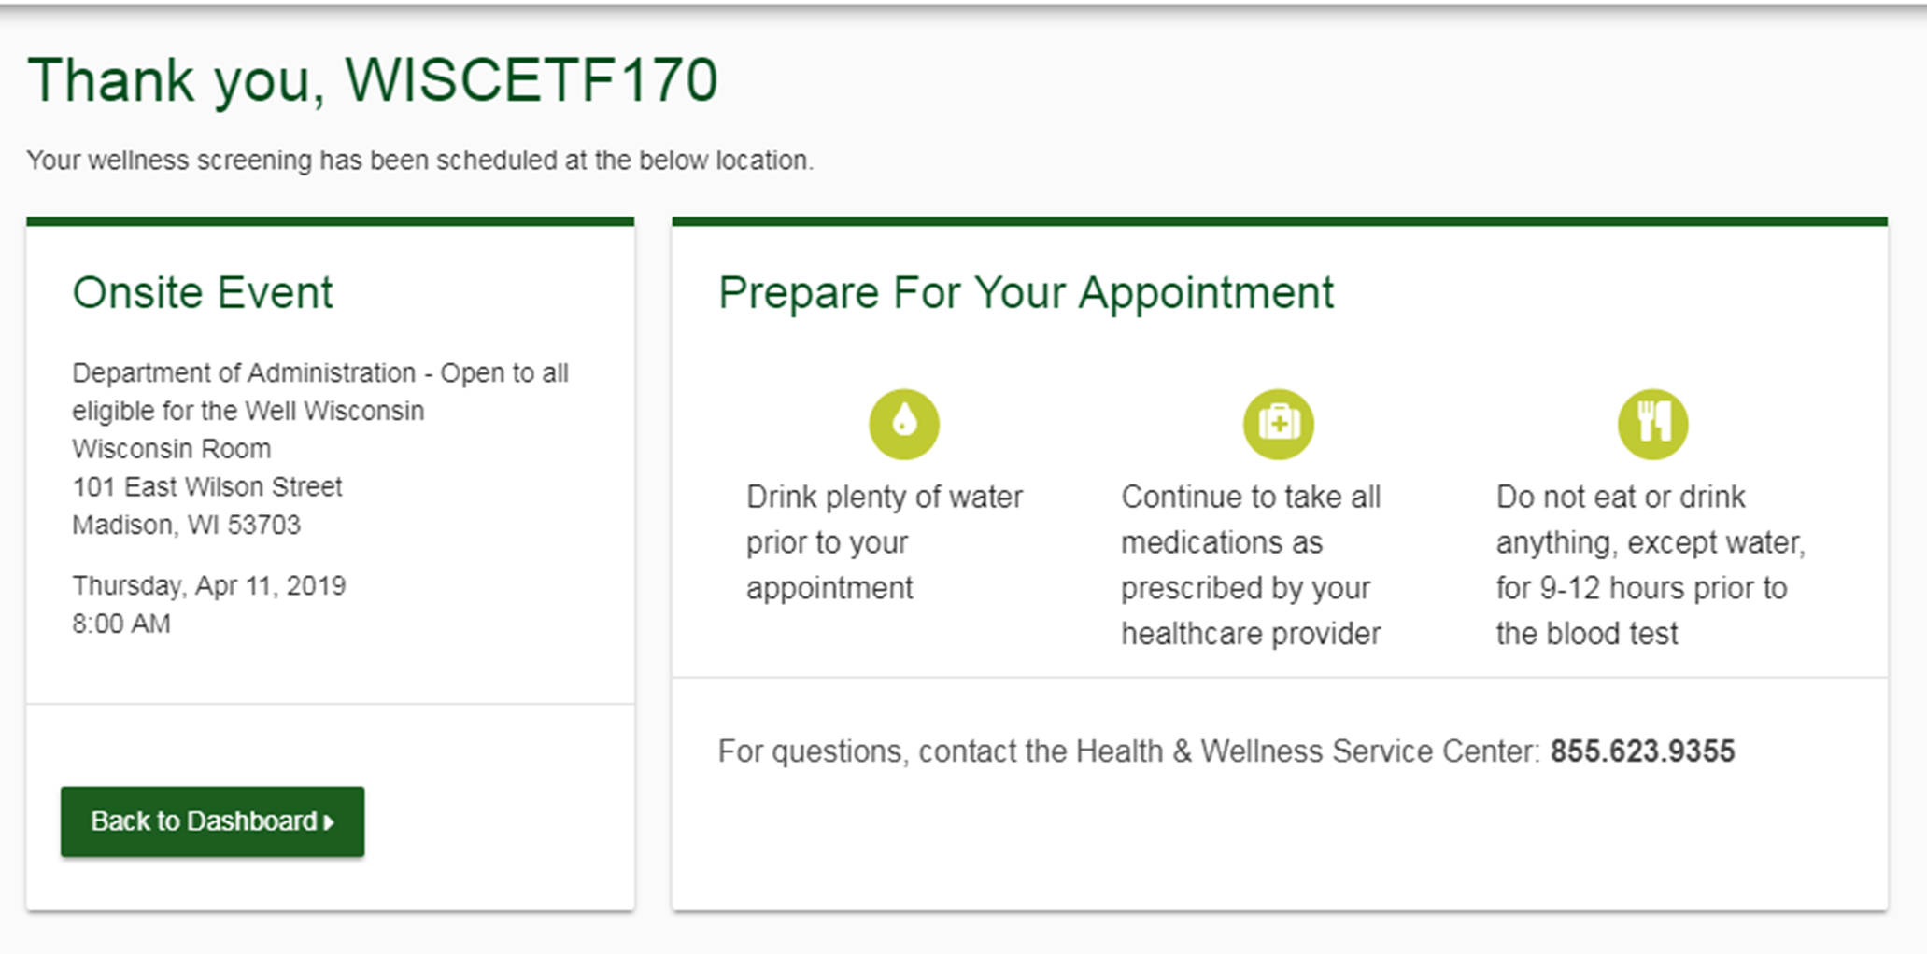
Well Wisconsin
Registering for a biometric screening
Confirmation page includes appointment details
Confirmation email will be sent upon registration

Slide 8
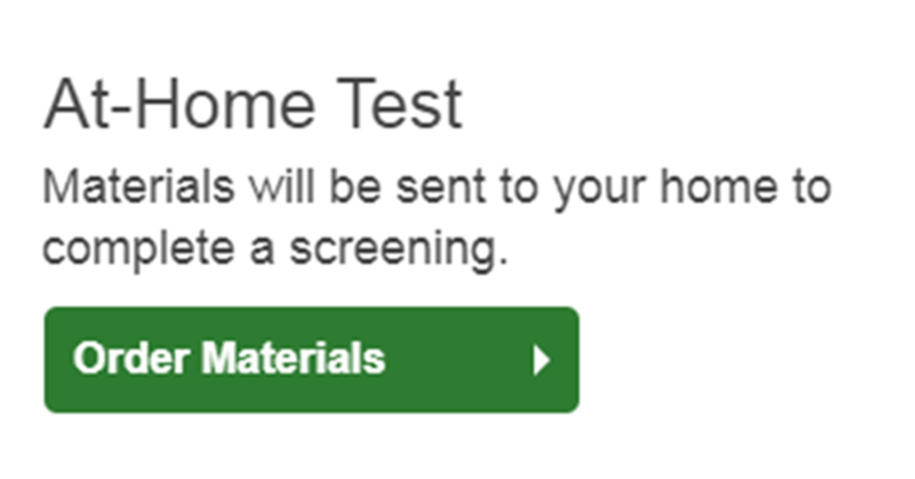
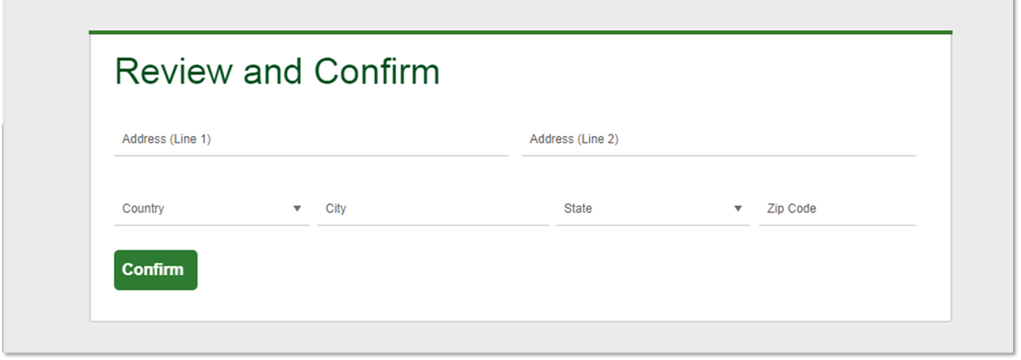
Well Wisconsin
Ordering self-collection materials
To order self-collection materials, click Order Materials
Review address and click Confirm

Slide 9
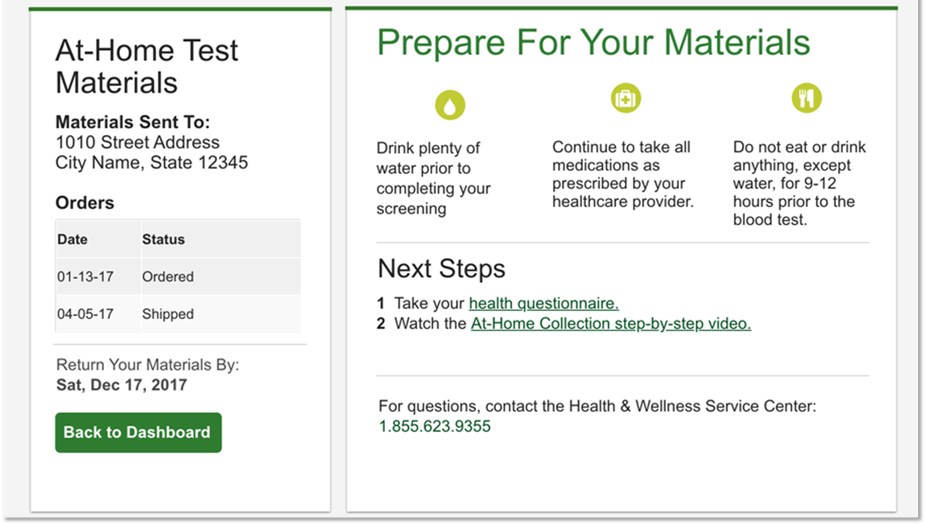
Well Wisconsin
Ordering self-collection materials
Confirmation screening includes link to a step-by-step video
Confirmation email will be sent

