Slide 1
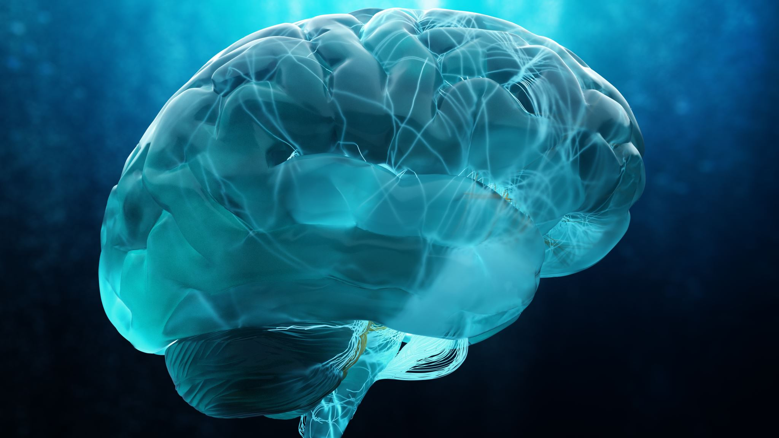
Brain-Based Connections: Understanding the neuroscience behind self-care
Amy Barth, PhD, LPC
Associate Professor
University of Wisconsin-Whitewater

Slide 2

Let’s get focused

Slide 3
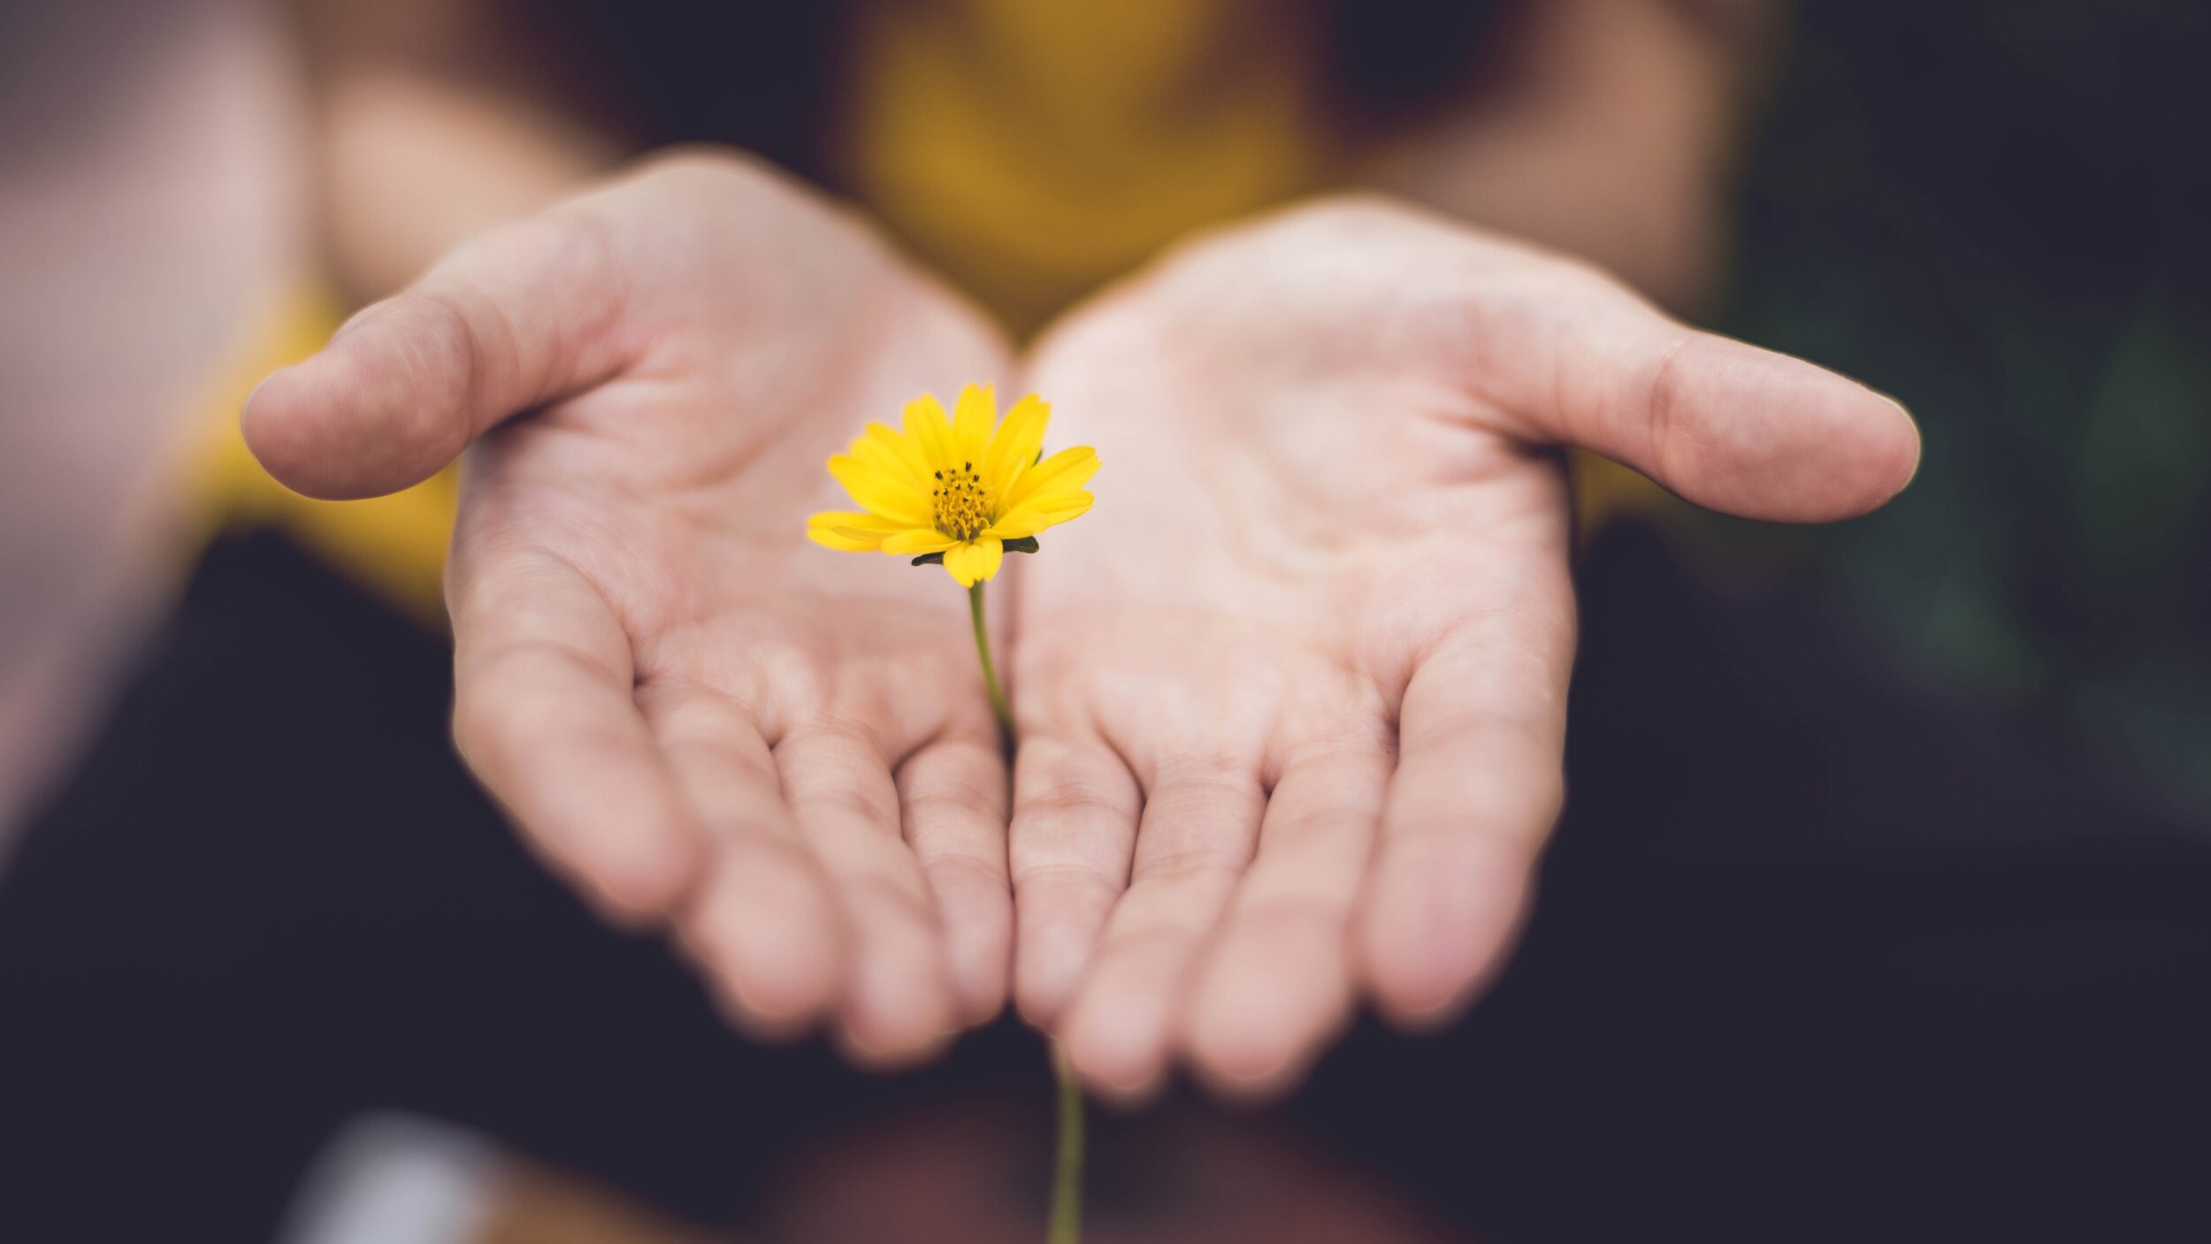
Why is self-care so important?
“How we care for ourselves gives our brain messages that shape our self-worth. So, we must care for ourselves in every way, every day.”
– Sam Owen
“An exhausted, frustrated, dysregulated [counselor] can’t regulate anybody”. Perry (2021)
This Photo by Unknown Author is licensed under CC BY-SA

Slide 4
Self-care definition
Self-care, across disciplines, emerges as a holistic, intentional, and empowering process that blends individual autonomy, preventive health, coping, and resilience within both personal and professional contexts. It is at once a personal practice, ethical obligation, and communal strategy that fosters optimal well-being, not only by reducing risks (burnout, illness) but by cultivating growth, meaning, and flourishing.
Perplexity AI. (2025). Synthesis of themes for self-care definitions.

Slide 5
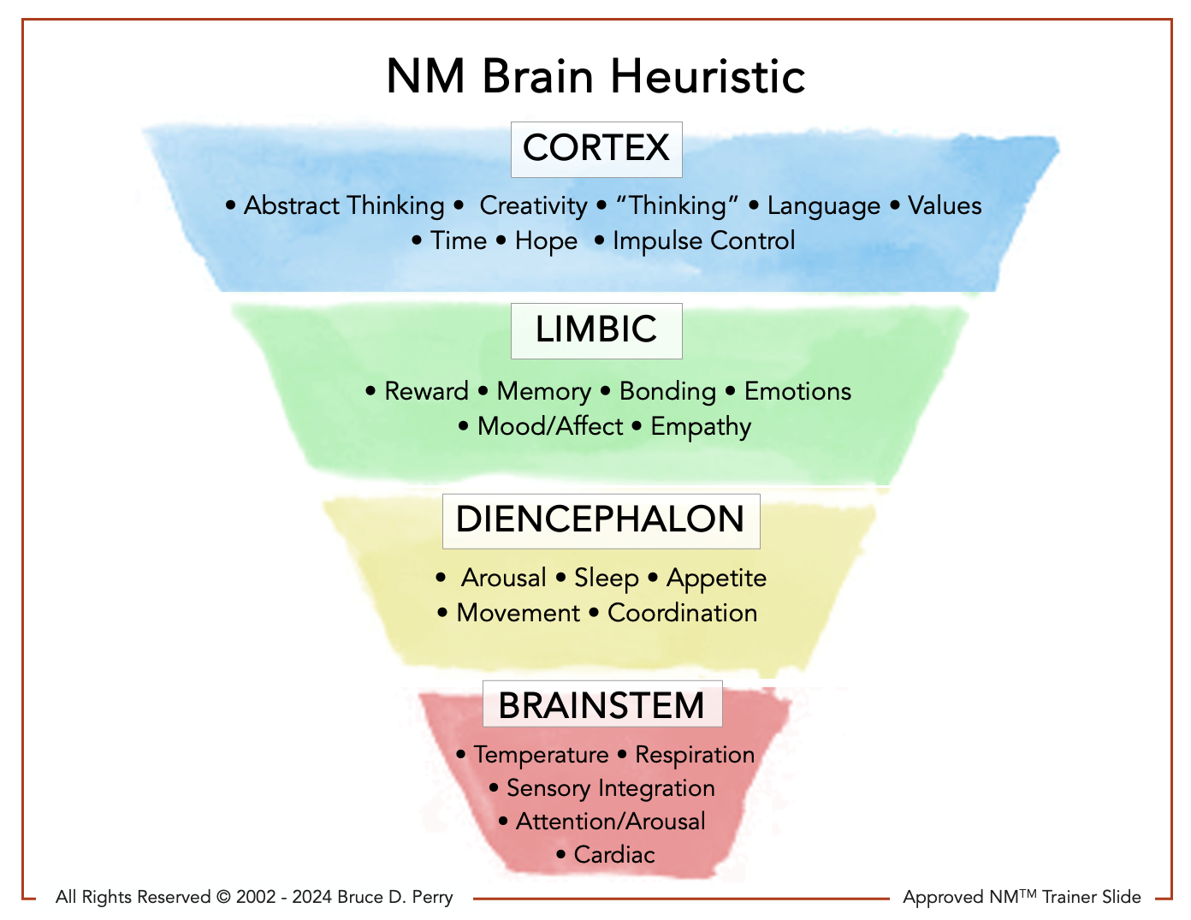
NM Brain Heuristic
© Copyright

Slide 6
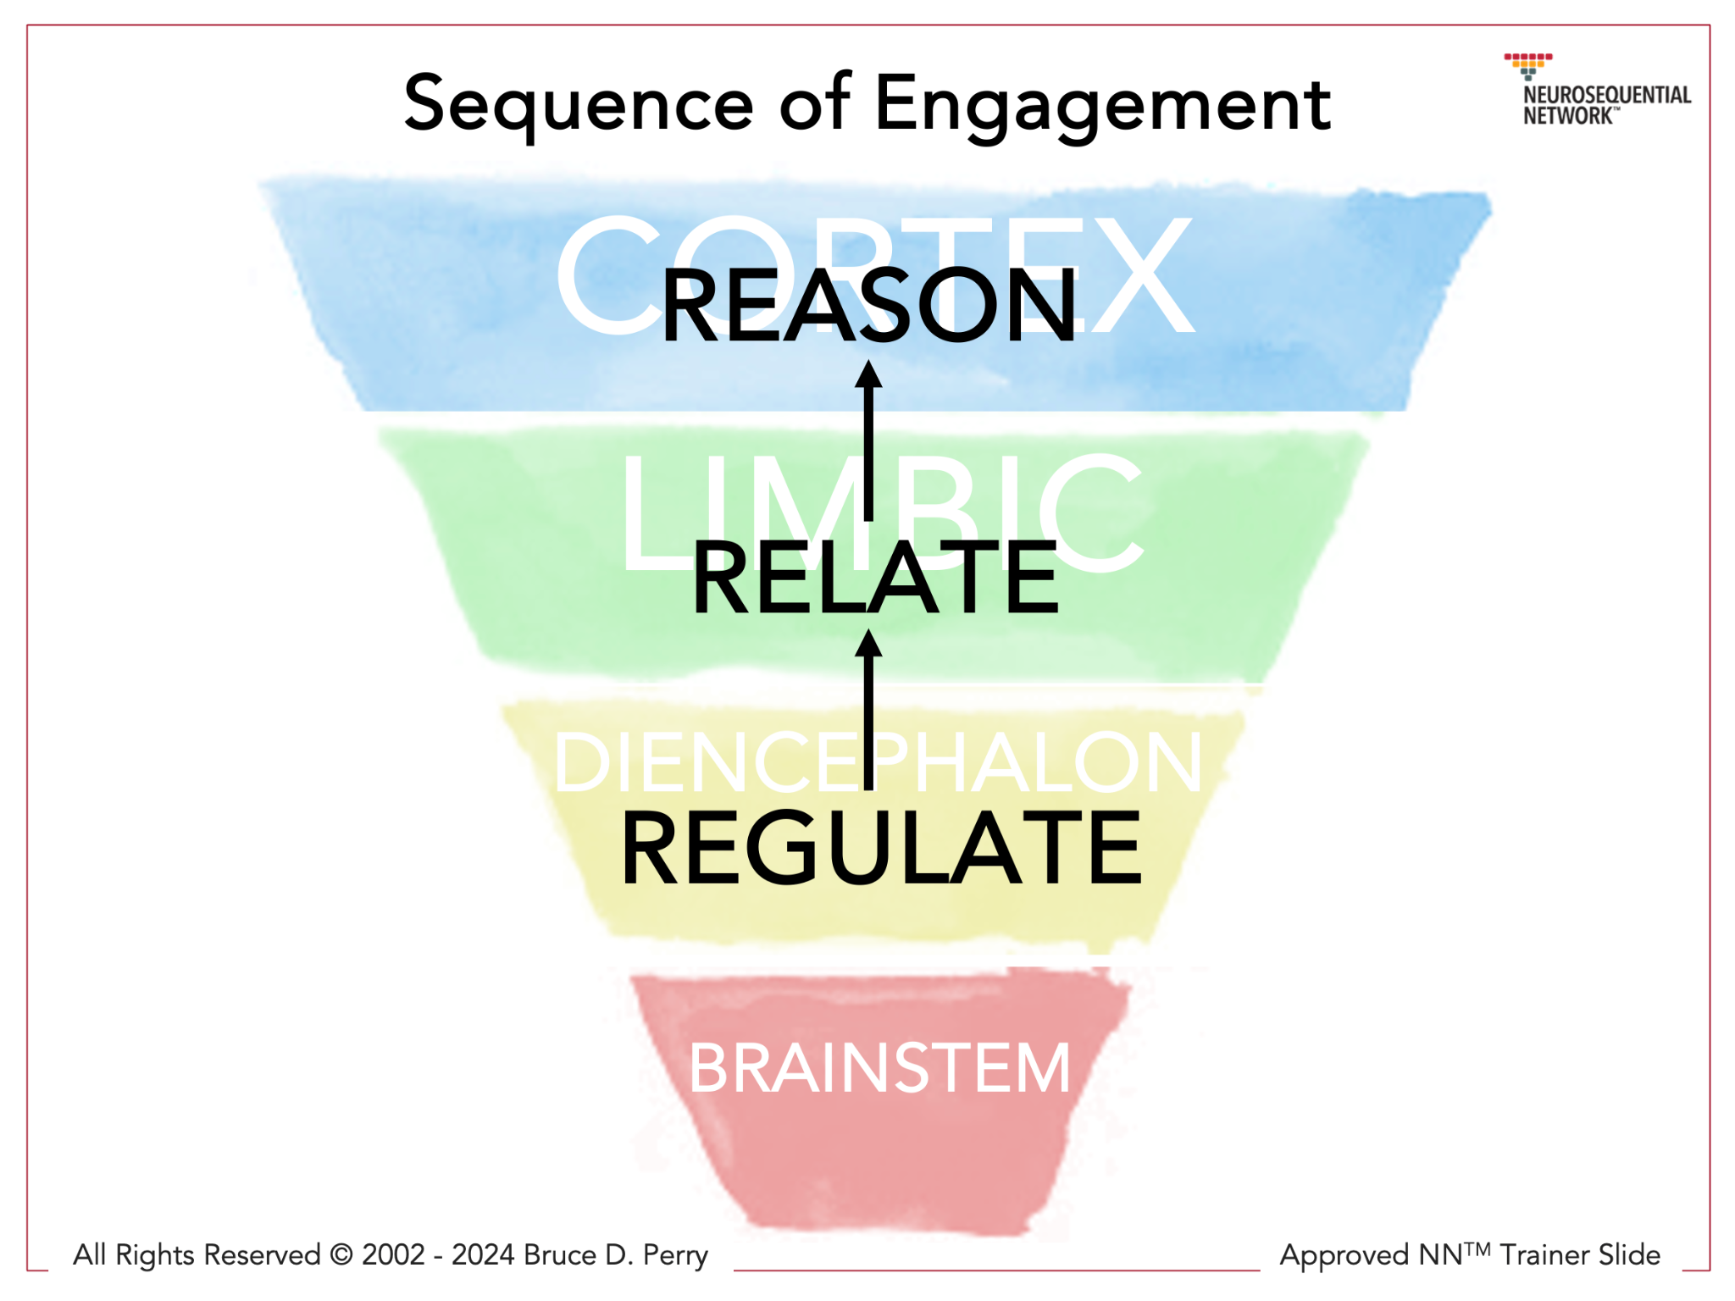

Sequence of engagement

Slide 7
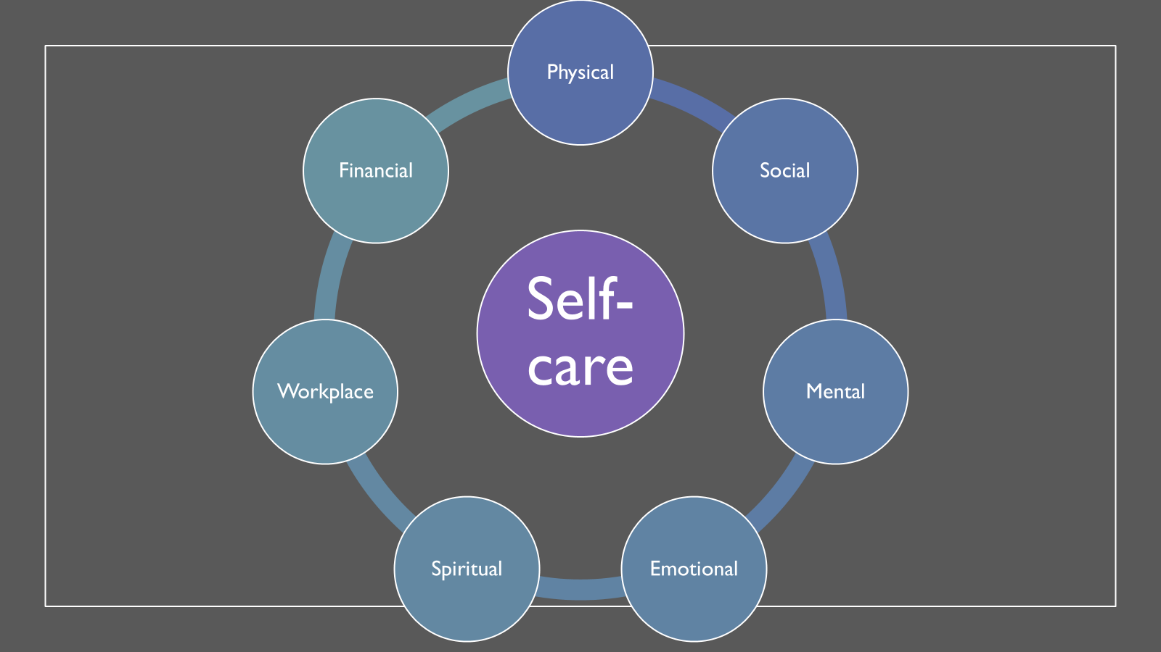
Self-care wheel

Slide 8

Developing your own self-care plan
Reflect on your strengths and needs
Assess your coping strategies
Consider your stressors
Devise self-care strategies that work for you
What are you already doing?
What do you want to add in?
Plan for challenges
Start small
Schedule time to focus on your needs

Slide 9
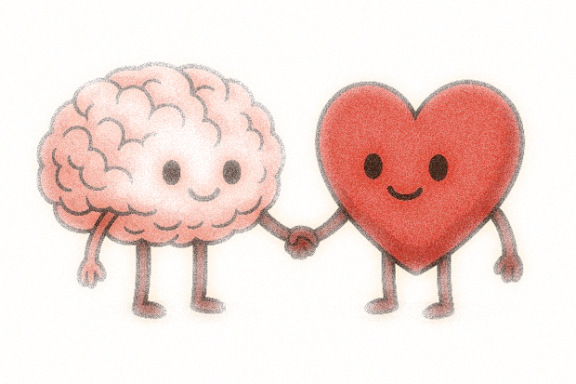
Let’s reflect on your own self-care

Slide 10
Consider …
Self-care as an intentional daily practice.
Self-care practices both personally and professionally.
Having some SOS self-care strategies for unexpected and/or extremely stressful situations.
How regular self-care promotes optimal functioning and well-being.
How self-care can help reduce risks for physical and mental health struggles.
How self-care can help you grow and flourish through finding what is meaningful to you.
Remember – regulate, relate, and reason.

Slide 11

takeaways

Slide 12

Self-Care Ideas
What is Self-Care
Mental Health America – 50 ideas
5 types of Self-Care for Every Area of Your Life
100 Self-Care Ideas
Self-Care Checklist

Slide 13
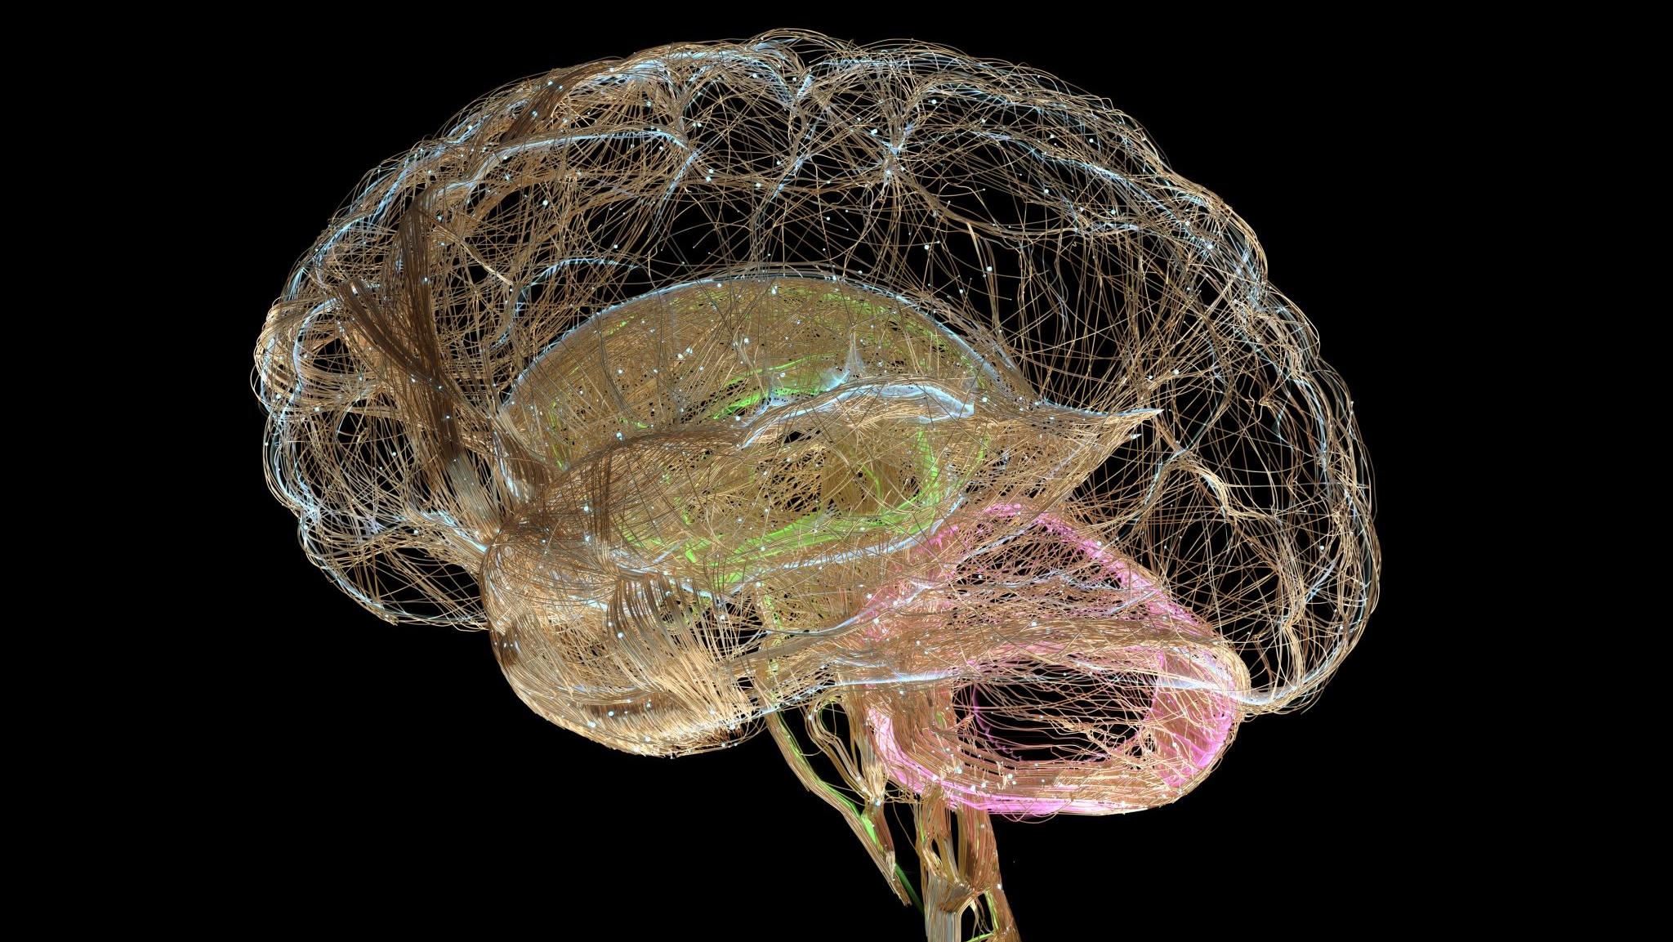
References
American Counseling Association (2014). ACA Code of Ethics. Retrieved from www.counseling.org.
Banks, A. (2016),.Wired to connect: The surprising link between brain science and strong, healthy relationships.
Martinez, N., Connelly, C. D., Perez, A., & Calero, P. (2021). Self-Care: A Concept Analysis. International Journal of Nursing Science, 8, 418-425. https://doi.org/10.1007/s10447-019-09382-w
Perry, B. D., & Winfrey, O. (2021). What Happened to You? Conversations on Trauma, Resilience, and Healing.
Posluns, K. , & Gall, T. L. (2019). Dear Mental Health Practitioners, Take Care of Yourselves: A Literature review on Self-Care. International Journal for the Advancement of Counselling, 42, 1-20. https://doi.org/10.1007/s10447-019-09382-w
Skovholt, T. M., (2012). The Counselor’s Resilient Self. Turkish Psychological Counseling and Guidance Journal, 4(38), 137-146.

Slide 14
For more information on the neurosequential model and training
The Neurosequential Network https://www.neurosequential.com/
ChildTrauma Academy https://www.childtrauma.org/
Think TV PBS Series w/ Dr. Bruce Perry https://wisconsin.pbslearningmedia.org/collection/stress-trauma-and-the-brain-insights-for-educators/
Seven Slide Series https://www.childtrauma.org/brain-dev-neuroscience

