Slide 1


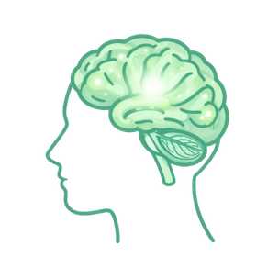
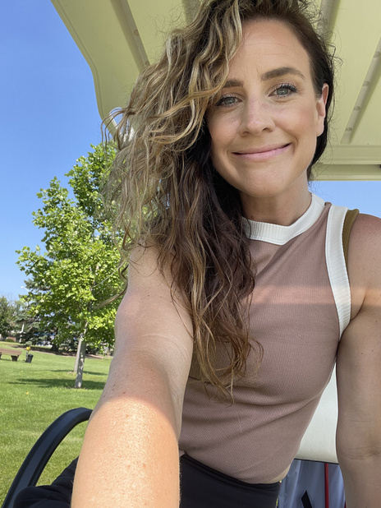
Boundaries &
Self-Understanding
Harnessing Metacognition for Clear Self-Leadership
Strong Culture
Presented by
Laura Newman
Founder of Strong Culture | MSCJ, MHFA, CPT, GFI

Slide 2



Slide 3
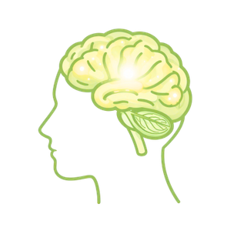
Learning Objectives
  Recognize how perception affects boundaries in high-stress situations.
  Explore metacognition to enhance intentional action for real-time application.
  Use two mental models for clarity under stress.
  Convert self-awareness of your patterns into action

Slide 4



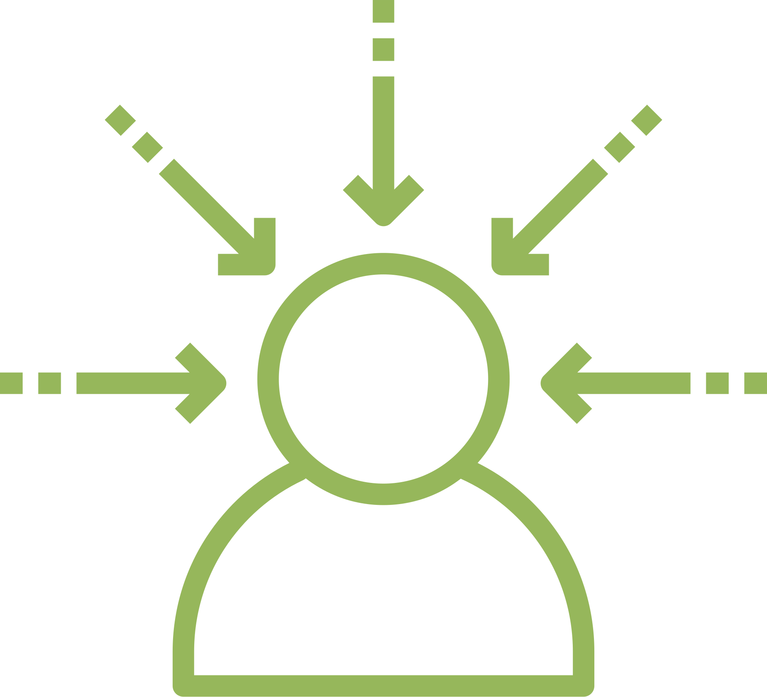
Perception and Interpretation
We don’t respond to reality—we respond to our interpretation of it
Filters
Brain interprets
Predicts
Your brain filters information, makes comparisons, and assigns meaning.
It fills in the gaps in understanding. It draws on past experiences.
It predicts current conditions based on past patterns and forecasts future events.

Slide 5

Stress Narrows Our Perception
Stress changes what we are able to see, interpret, and consider.
1
Narrowed
We see less of the full picture.
2
Threat-Focused
We notice risk, criticism, pressure, or failure faster.
3
Automatic Response
“I react before I reflect.”

Slide 6
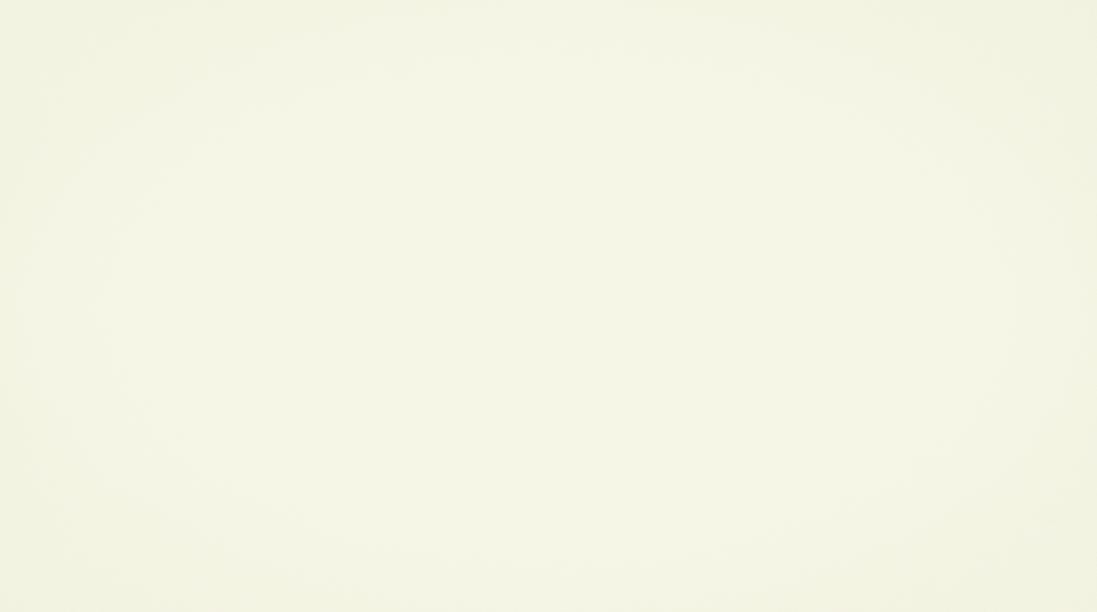
The Prefrontal Cortex Under Stress
Stress makes it harder to access what we know
Depleted
Planning
Overloaded
Decision making
Less flexible
Flexibility
More reactive
Impluse control

Slide 7

What Stress Impairs
Under stress, the brain deprioritizes higher-order thinking.
Flexible Thinking
Harder to see alternatives or shift perspective
Working Memory
Harder to hold multiple pieces of information at once
Impulse Control
Quicker to react, slower to pause
Future Planning
Focus narrows to the immediate moment
Emotional Regulation
Feelings intensify and become harder to manage

Slide 8

The Brat Scenario
You're enjoying a baseball game, and the fan sitting next to you has been a joy to be around. You've shared high-fives and laughter throughout the game. You offer to buy a treat for your new friend, and you both decide on a bratwurst. However, the vendor informs you that only one brat remains.
A. Purchase the brat for yourself, and then inquire about what else they would like.
B. Let them have it because they were fun and you want to be nice.
C. Expect them to offer it to you because you entertained them all game.
D. Offer to split it, even though splitting a stadium brat is questionable.
E. Panic internally and order nachos you did not even want.

Slide 9


Your answer reveals more than a snack preference
The Brat is not the point the pattern is...
  Where do you find yourself compromising?
  Giving in - even when you don’t want to?
  Unable to take what you actually need?
  Filling your plate with things that aren’t yours to carry?
  Keeping the peace instead of keeping your time?
These patterns don’t start at work. They start with the lens you’ve been wearing - the one shaped by your roles, your past, and the story you tell yourself about who you’re supposed to be.

Slide 10

What is Metacognition?
Metacognition is "thinking about thinking." It allows us to pause, recognize our thinking patterns, and make more intentional decisions rather than reacting on autopilot.
Key Contributors
John Flavell & Ann Brown
Thomas O. Nelson
Lev Vygotsky
proposed and made significant contributions to how metacognition and self-regulation are applied in learning and education.
Further developed research surrounding computational models of metacognition and memory monitoring.
Often credited as an earlier historical influence whose foundational work in developmental psychology paved the way for metacognitive research.

Slide 11

The Three Components of Metacognition
Knowledge of Your Thinking
Monitoring Your Thinking
Regulation of Your Thinking
  Understanding how your mind tends to process information.
  Recognizing your thought patterns, assumptions, and mental habits
  Knowing what situations tend to trigger stress, defensiveness, or overthinking
  Understanding that your perception is shaped by past experiences, roles, and pressure
  Noticing your thoughts while they are happening.
  Catching yourself in real time before reacting
  Asking, “What am I assuming right now?”
  Noticing when stress is narrowing your focus or speeding up your interpretation
  Choosing how to adjust your thoughts, response, or next step.
  Slowing down before responding
  Separating what actually happened from the story you are telling yourself
  Reframing, seeking clarity, or choosing a more effective response
"I know how my mind tends to work."
"I can notice what my mind is doing."
"I can pause, adjust, and respond thoughtfully."

Slide 12
Mental Model One: What Shapes Your Lens?
Your lens is the internal framework you use to interpret what is happening around you
The role you're used to playing
Your past patterns
  "I'm the reliable one... I just handle things."
  "If I don't do it, no one will."
  "People count on me to hold it together."
  "I've always been the one who says yes."
  "I learned early that my needs come last."
  "Saying no has never felt safe for me."
Your current capacity
Your identity and expectations
  "I'm already overwhelmed, even if I'm not saying it out loud."
  "I don't have the bandwidth, but I keep showing up anyway."
  "My body is telling me to stop, but I won't listen."
  "The one who never drops the ball."
  "The calm one who holds everyone else together."
  "The person who makes it look easy, no matter what."

Slide 13

What Happens to Our Lens Under Stress?
Automatic Patterns: Default Mode
  Old patterns get louder and feel more urgent.
  Reflection shifts to reaction.
  Every situation seems urgent or personal.
  The phrase "I can" transforms into "I should."
  Boundaries become harder to see clearly.
When you've never examined the lens, stress doesn't just blur it - it takes over completely.
Notes:
“Now, this lens is operating all the time. But under stress, it becomes harder to notice. Stress narrows our perspective. It makes our old patterns feel urgent, necessary, and true.”
“So if my normal pattern is to over-function, stress will tell me, ‘You have to handle this.’
If my normal pattern is to people-please, stress will tell me, ‘You can’t disappoint them.’
If my normal pattern is to push through, stress will tell me, ‘You don’t have time to stop
Under stress, the brain does not usually ask, ‘What is the most aligned response?’ It asks, ‘What will relieve the pressure right now

Slide 14
The Boundary Breakdown
The lens we are operating through makes it hard to honor what we need
We may know we need rest, but our lens says, ‘You should be able to handle this.
We may know we need help, but our lens says, ‘Don’t be a burden.’
We may avoid hard conversations because our story says conflict means rejection.
We may know we need to speak up, but our lens says, ‘Keep the peace.’
We may feel trapped in cycles because our lens says nothing will ever change.
We may know we need to say no, but our lens says, ‘People will be disappointed.’”
Metacognition is the pause between perception and action. Notice the lens, name the story, and choose a different response.
That's where boundaries begin.

Slide 15
Boundaries, Reframed
Boundaries are not where self-understanding begins.
They are what self-understanding makes possible.
  Your boundaries are not only broken by other people’s demands.
  They are often broken by your own internal patterns, beliefs, roles, and pressure.
  When I notice the story, I can choose my response.
  When I choose my response, boundaries become clear in action.

Slide 16
Mental Model #2: Signal vs. Story
The Signal
The Story
The signal is the observable part of the moment.
• What was said
• What actually happened
• What you can see, hear, or verify
The story is the meaning your mind adds.
• "They don't respect me"
• "I should just handle it"
• "If I don't do it, it won't get done right"
• "This is going to be a problem"

Slide 17

“Tell Me About Your Weaknesses”
The Signal
The Story We Tell Ourselves
What are your weaknesses?
• "I'm a perfectionist."
• "I go above and beyond."
• "I take on a lot."
• "I never miss deadlines."
  “If I admit my limits, I’ll lose value.”
  “If I say I can’t, I’ll look weak.”
  “If I stop performing, I’ll be replaced.”
  “So I present strength instead of honesty.”
The resume version of confidence isn’t sustainable.

Slide 18
When the Story Becomes a Lifestyle
A signal happens.
A story forms.
  Someone asks about your weaknesses.
  You receive feedback.
  You hit your limit.
  You disappoint someone.
  You need rest.
“If I admit this, I’ll lose respect.”
“If I have limits, I’m less valuable.”
“If I can’t keep up, I’m failing.”
“If they see the truth, I won’t be chosen.”
The story becomes a rule.
The rule becomes a lifestyle.
“Never show weakness.”
“Always be available.”
“Keep proving yourself.”
“Don’t need too much.”
“Perform through it.”
And now you are not just responding to a moment.
You are organizing your life around a belief you never stopped to question.
We don’t just tell stories. Sometimes we start living inside them.
Notes:
Confidence at work is not pretending you have no limits. Confidence is being grounded enough to tell the truth about your strengths, your scope, and your current capacity

Slide 19
Boundaries, Reframed
Boundaries do not make us less committed. They help us stay honest, sustainable, and aligned.
  “This is what I can offer.”
  “This is what I cannot carry.”
  “This is what I need in order to show up well.”
  “This is where my responsibility ends.”
  “This is where I need to pause before responding.”

Slide 20
Putting Metacognition in Real Time
A Repeating Loop for Catching Patterns Before They Become Decisions
1
Notice
What am I feeling, assuming, or reacting to?
2
Name
What lens or story might be shaping this?
3
Choose
What response reflects clarity instead of autopilot?
4
Check
Did this response align with my values, capacity, and boundary?
This loop repeats — building awareness one cycle at a time.
Notes:
“This is what metacognition looks like in real time. It does not mean we stop and analyze everything for twenty minutes. It means we create a small pause before our pattern becomes our decision.”
Then:
“First, I notice what is happening in me. Am I anxious? Defensive? Overwhelmed? Rushing to fix? Then I name what might be shaping my interpretation. Is this my stress lens? My people-pleasing lens? My responsibility lens? Then I choose a response that reflects clarity instead of autopilot. And afterward, I check in: did that response actually align with the kind of person, leader, coworker, or communicator I want to be?”

Slide 21
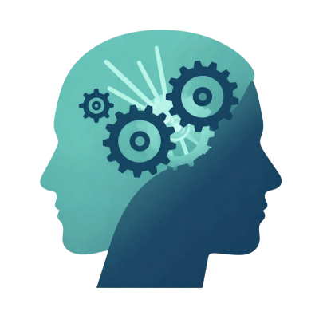
Regulation of Your Thinking: Adjust the Lens
Slow down before responding.
Create enough space to notice what your lens is doing.
1
Separate what happened from the story you're telling yourself.
Ask: What do I know for sure? What am I assuming?
2
Reframe with clarity.
Seek more information, adjust the meaning, or choose a more effective response.
3
Choose your next step intentionally.
Respond from alignment, not autopilot.
4
Notes:
“Regulation is where metacognition becomes action.
It’s not just noticing that I’m thinking a certain way — it’s choosing what to do with that awareness.”
“If my lens is telling me, ‘I have to say yes or I’ll disappoint people,’ regulation helps me slow down and ask, ‘Is that true? What actually happened? What am I assuming?
What response would protect both my professionalism and my capacity?’
“This is where boundaries become possible. Because once I can regulate my thinking, I’m not just reacting to pressure. I’m choosing a response that reflects clarity.”

Slide 22
Rewriting the Story With Clarity
The Clarified Signal
The Story We Choose
Owning your limits with confidence:
  “I know what I do well.”
  “I know what is beyond my capacity.”
  “I can be honest without shrinking my value.”
Redefining honesty as strength:
  “This is who I am.”
  “This is what I can offer.”
  “This is what I cannot keep performing.”
Honesty about limits is not weakness —
it is leadership.
Notes:
Confidence at work is not pretending you have no limits. Confidence is being grounded enough to tell the truth about your strengths, your scope, and your current capacity

Slide 23
Uniting Everything Together
Lens → Story → Response → Boundary
MENTAL MODELS
THE AWARENESS
THE CHOICE
LENS
METACOGNITION
BOUNDARIES
↓
creates the pause
become the aligned action
SIGNAL STORY
Thinking about your thinking.
Noticing before reacting.
Where you end and others begin.
Clarity without guilt.
Stronger people build stronger cultures.

Slide 24
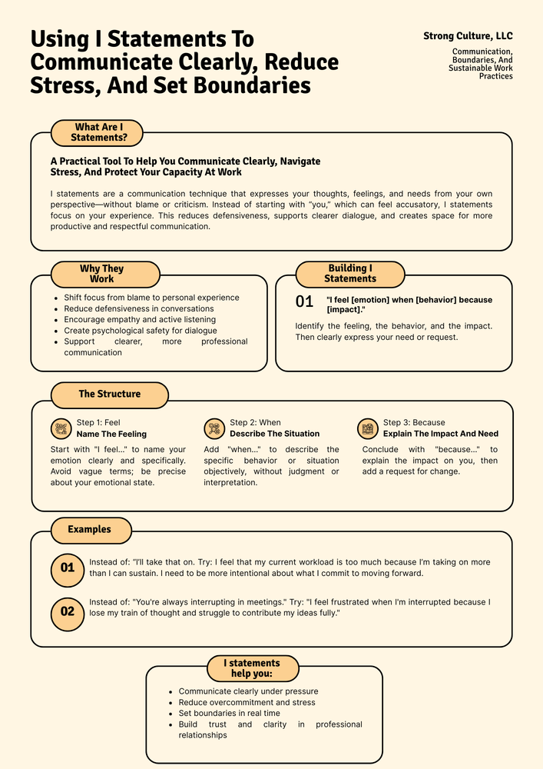
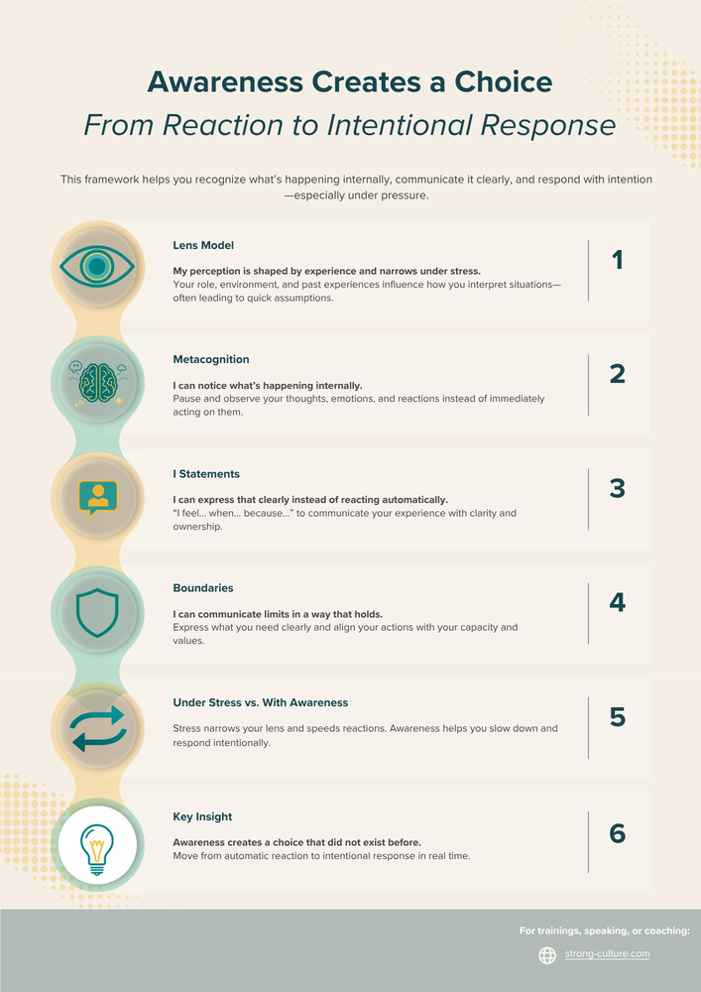

Slide 25

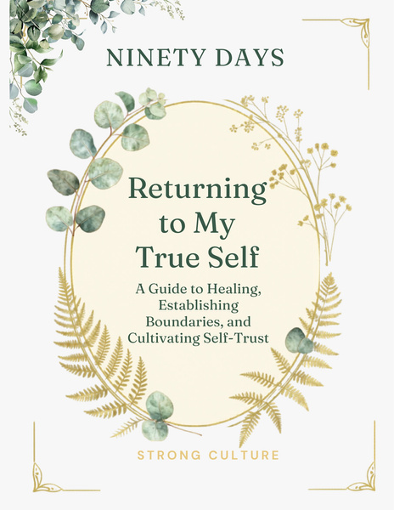
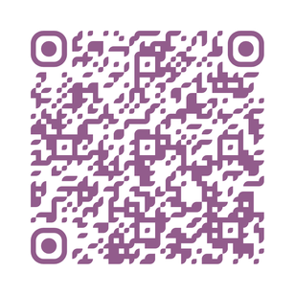
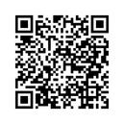
Continue the Work Beyond Today
A boundary is not a barrier; it is a form of clarity that you can actively implement.
Faith-Based Boundaries Journal
Boundaries Journal
For those who want to explore boundaries
through reflection, scripture, and spiritual grounding.
For reflection, self-understanding,
and practical boundary work.
strong-culture.com/shop
strong-culture.com/shop

Slide 26

Thank You
Wherever you are in your journey, you belong here.
Every story, every pace, every starting point matters.
Your presence today made this space stronger.
Stronger people build stronger cultures.
Laura Newman | Strong Culture, LLC
connect@strongculturecollc.com | @strong_culture_

