Slide 1
Investigation Practical Skills
UWSA Office of Compliance and Integrity
UW Law Days
February 24, 2026
Claire Edwards, Title IX and Equal Opportunity Investigator
Haley Hintz, Title IX and Equal Opportunity Investigator

Slide 2
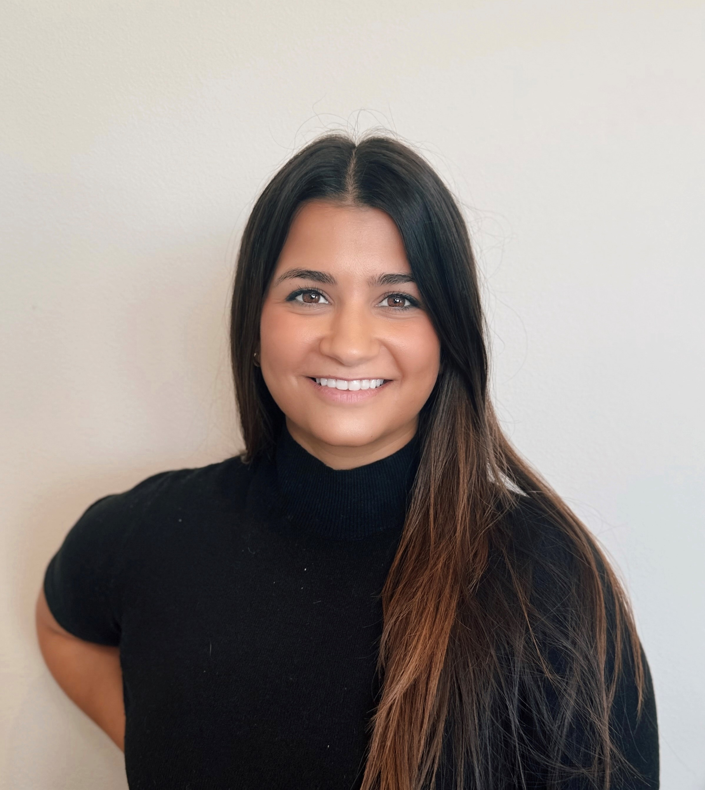

OCI Investigators
Claire Edwards
Juris Doctor (University of Wisconsin Law School)
Bachelor of Arts, Criminal Justice and Sociology (State University of New York – Albany)
Haley Hintz
Master of Legal Studies, Sports Law and Criminal Law Emphasis (Arizona State University, Sandra Day O’Connor College of Law)
Bachelor of Arts, Psychology and Criminology (University of Wisconsin Whitewater)

Slide 3
Investigations are…
Investigations are prompt, fair, impartial, equitable, adequate and reliable.

Slide 4
Investigation framework
Typically, investigations take 90 to 120 days.
Interviews are typically conducted via Zoom. In – person meetings are offered in all Title IX cases and if requested in all other investigations.
Dual Investigator Model – Both Investigators present at every meeting and interview.
Investigators forward any questions related to the process or policy to the university contact.

Slide 5
Initial investigation considerations
Scope of Investigation
Priority
External Factors

Slide 6
Scope of Investigation
Determine Parameters of Investigation
  Date Range
  Policy
  Identification of Parties
  Parties Employment/Student Status
Notice of Investigation
University Contact
  Investigator’s Point of Contact
  Decision Maker

Slide 7
Factors to consider for Priority Status
The Respondent is placed on Paid Administrative Leave.
The Respondent (Employee) is subject to contractual timelines that affect their rights, applicable procedures, or policy requirements.
The Respondent (Student) is approaching graduation and/or has pending student affiliation obligations (Ex. athletics)
There is a risk of reputational harm to the University and/or increased public or media interest in the matter.

Slide 8
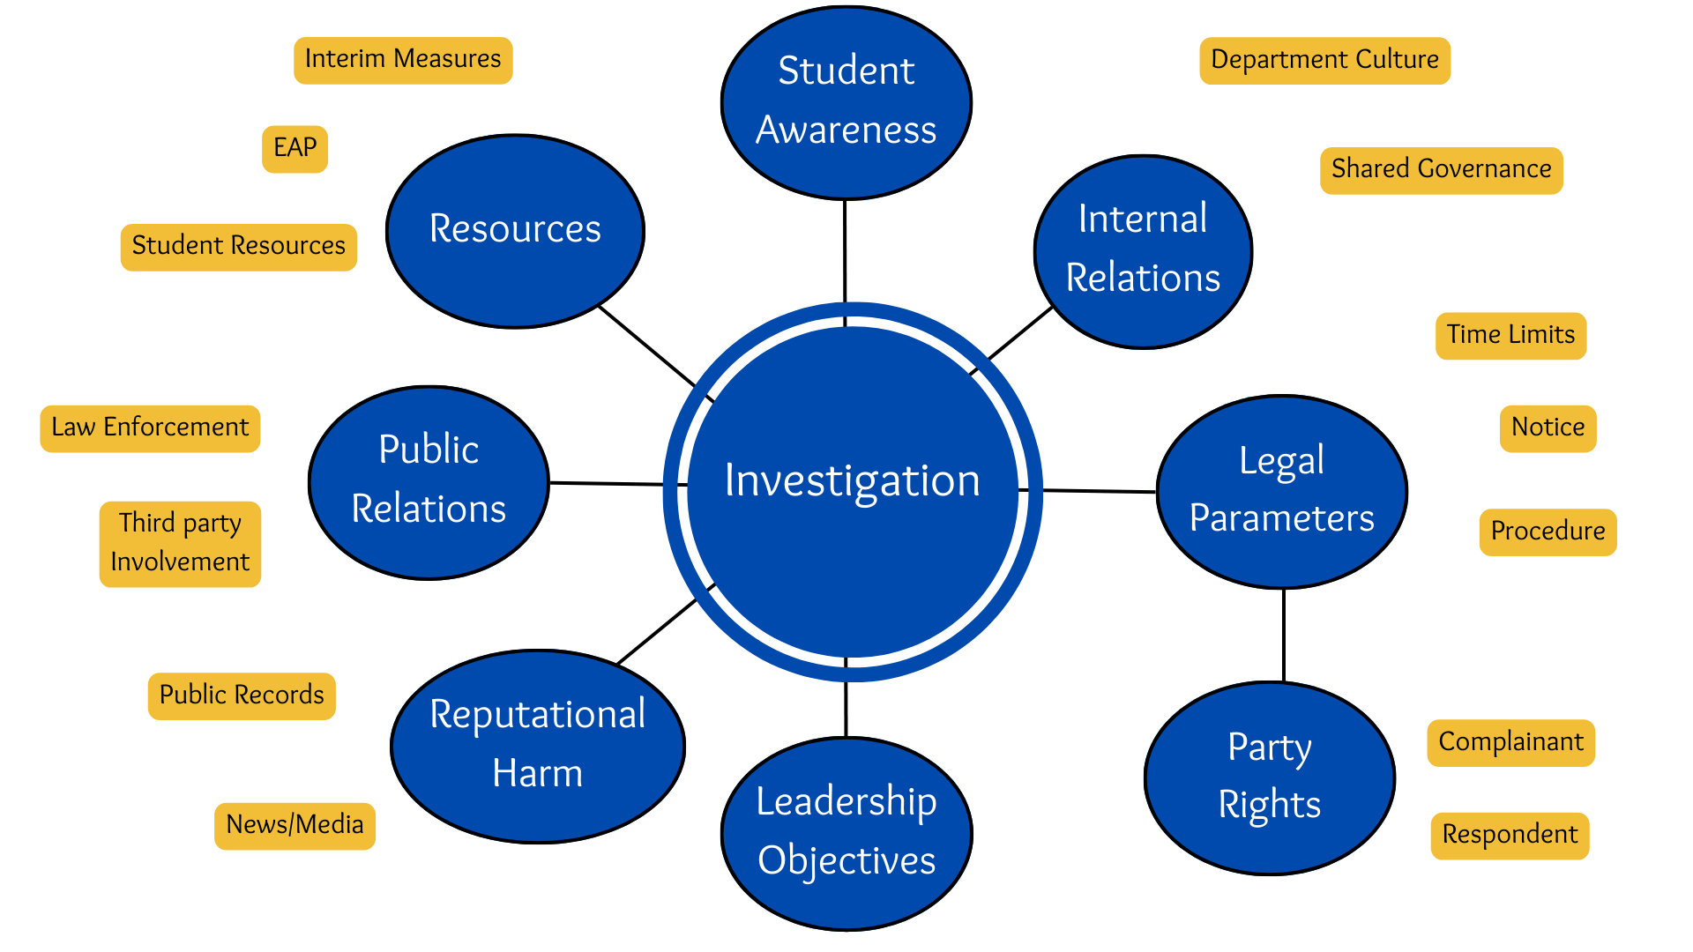
External Considerations with an investigation

Slide 9
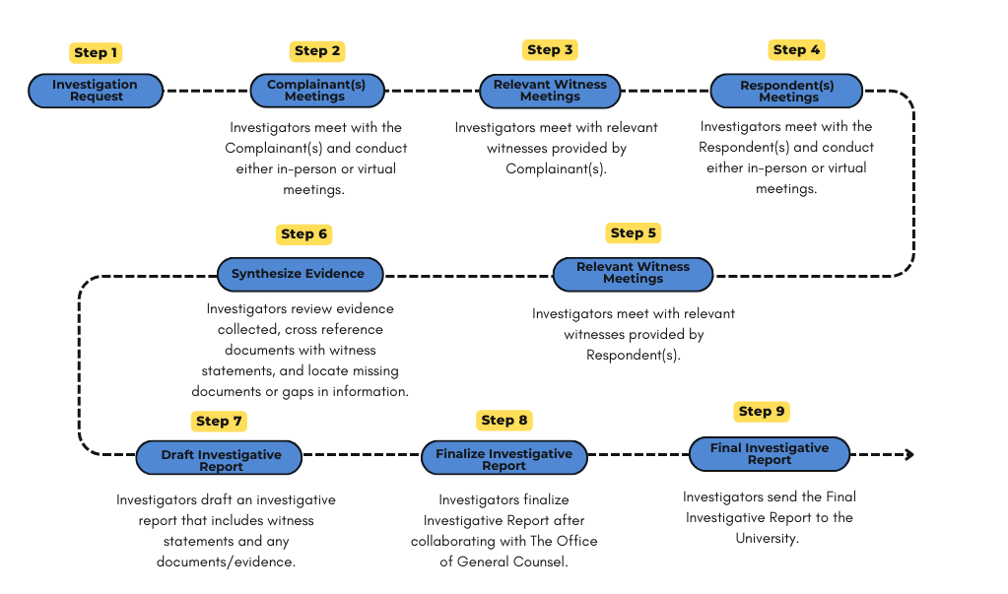
Investigation process overview

Slide 10
Investigation strategy
Sequence of interviews:
  Complainant
  Witnesses identified by complainant, initial documents, and/or investigators
  Respondent
  Witnesses identified by respondent
Follow up with parties if necessary

Slide 11
Tips for conducting the interview
Flexibility
Patience
Listening
Silence
Neutrality
Recognize bias
Contradictory information

Slide 12
Interview techniques
Open ended questions
Allow parties to use their own words
Use words the party understands/mimic words the party uses
Begin with lower stake questions
Avoid leading questions
Be sure to get all relevant details
End with – “Is there anything else you’d like to add” and “Is there anyone we should speak to”

Slide 13
Investigation records
Letter of Engagement
Scope of Investigation
Meeting Notes
Policy
Evidence
Reports
Investigator Communication
Time Tracker
Closing Form

Slide 14
Credibility analysis
Inherent plausibility
Motive to falsify
Corroboration
Past record
Demeanor (use caution!)

Slide 15
Final report
Investigators collaborate with OGC when drafting the report.
Investigators do not finalize the report until the university contact reviews and approves the report.
Title IX reports include all witness statements in the body of the report.
Other types of investigations may include a summary of all witness statements in the body of the report and/or appendix.
All reports contain an analysis or summary drafted by the investigator. The university contact and OGC should discuss what type of analysis is best based on the policy and allegations.

Slide 16
Investigative Report types
Evidence Gatherer:
The investigative report will include complete witness statements for all interviews conducted. Investigators will highlight disputed and undisputed facts in their analysis. Investigators will also provide an overall credibility assessment of key individuals in their analysis.
Investigators will highlight other notable information gathered or observations made during the course of the investigation.
Typically, used in Title IX.
Evidence Synthesizer:
Investigators will compile a complete, accurate, and fair summary of witness statements. This comprehensive summary will include a credibility assessment for critical conflicting information to determine the validity of claims and contributing factors to the allegations. Complete witness statements may be provided in the appendix and will not be in the body of the report.
Investigators will apply relevant facts to policy but will not make a determination as to whether the policy was violated.
Determination Recommender:
[Synthesizer] +
Investigators will provide a determination of whether relevant policy was violated by the standard of proof.

Slide 17
High profile investigations
Sun Prairie West Title IX Investigation

Slide 18
Questions or comments?
Thank you!

