Slide 1
Due Process & Hearsay in University Proceedings
UW Law Days 2026
Rachel Pings Assistant Division Administrator and Administrative Law Judge, Wisconsin Division of Hearings and Appeals
Quinn Williams General Counsel, Universities of Wisconsin

Slide 2
introduction
Administrative Disciplinary Procedures for Student Non-Academic Misconduct
Sexual Misconduct
Subchapter III
UWS Ch. 17 Wis. Admin. Code
Title IX
Non-Title IX

Slide 3
Due process
Due process = fundamental fairness in the procedure and substance of the laws
  Notice of what is being alleged (final investigation report)
  Transparent procedures (UWS 17)
  Opportunity to be heard and present evidence (ALJ or committee hearing)
  Opportunity to test the evidence
  Fair and impartial fact finder and decision maker
Why it matters
  Wisconsin Administrative Code and Wisconsin caselaw requires a minimum level of due process related to evidence that can be relied upon in decisions by universities.
  Caselaw indicates that students may have constitutional rights such as occupational liberty interest, reputational interest, and/or property interest. Those rights cannot be infringed upon without due process.
  If responsibility is found, then sanctions can infringe on those rights. Wis. Admin. Code § UWS 17.085 (sanctions range from written reprimand to expulsion).

Slide 4
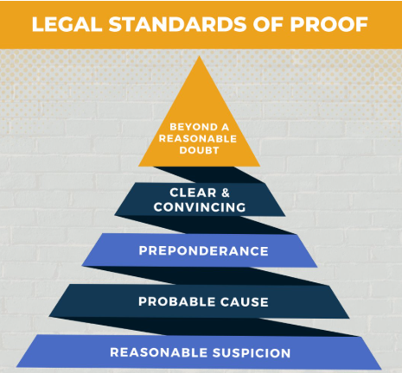
Burden of proof
Preponderance of the evidence. Wis. Admin. Code s. UWS 17.153(8).
“Information that would persuade a reasonable person that a proposition is more probably true than not true. It is a lower standard of proof than ‘clear and convincing evidence’ and is the minimum standard for a finding of responsibility under this chapter.” Wis. Admin. Code s. UWS 17.02(13).

Slide 5

How do you meet the burden of proof?
Tangible items, testimony, documents, or other information presented in a legal proceeding to prove or disprove the truth of an alleged fact.

Slide 6
Types of evidence
Direct
If true, this evidence directly proves or disproves a fact without requiring any inference or presumption by the fact finder.
Ex: A written or recorded confession by the suspect; eyewitness testimony "I saw him pull the trigger;" surveillance video of an assault from the alley behind a bar; testimony by a complainant that they were sexually assaulted.
Circumstantial
Indirect evidence that implies something but does not directly prove it.
Ex. A search of the suspect's home reveals the stolen property; the suspect's bank records show a large deposit right after an embezzlement occurred.
Hearsay
A statement made previously by a person who is not testifying at the hearing. Or a statement made by a person who is testifying at the hearing but refuses to be cross-examined. See UWS 17.153(5)(d).
Ex. A witness’s statement in a police report; testimony by a complainant that they were sexually assault but the complainant refuses to answer cross-examination questions (compare with above).

Slide 7
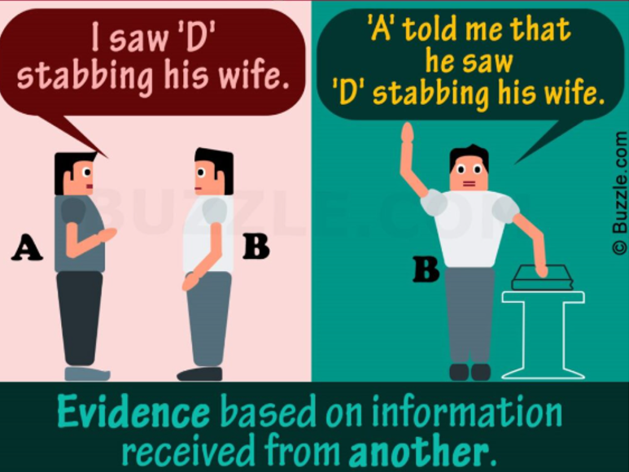
Hearsay is generally prohibited in court because of its questionable reliability
There is a reason fact finders don’t usually find hearsay reliable.
Person B has no personal knowledge of what really happened and can’t vouch for the truthfulness or reliability of Person A.

Slide 8
formal court rules of evidence do not apply in administrative proceedings
“The hearing process shall further the educational purposes and reflect the university context of nonacademic misconduct proceedings. The process need not conform to state or federal rules of criminal or civil procedure, except as expressly provided in this chapter.” Wis. Admin. Code s. UWS 17.153(4)(a).

Slide 9

due process is the focus
DUE
PROCESS

Slide 10
due process encourages participation at the hearing
Timely hearing encourages participation and good recall of events.
Hearing examiner can allow any information that has reasonable value in proving the facts.
Immaterial, irrelevant, or unduly repetitious testimony is excluded.
Advisors make the process less intimidating:
  Both parties get an advisor.
  Advisors (or third party provided by university) must conduct cross-examination.
    Hearing examiner will ensure all cross-examination questions are relevant and the tone is appropriate.
Universities can choose to use an ALJ as the hearing examiner, which might make it a bit more formal, but also lends significant experience and consistency (in the process and outcomes). Further, it alleviates the university from having to perform two roles (fact presenter and fact finder).

Slide 11
Best practice
Best practice is for both parties and all witnesses with direct knowledge to appear at the hearing to testify and be cross-examined. But the university and hearing examiner lack authority to subpoena a party or witness, make them testify, or make them answer all questions if they do testify.
What happens if they don’t?

Slide 12
Lack of participation at hearing
The hearing examiner cannot draw an inference regarding responsibility based solely on a party’s or witness’s absence from the hearing or refusal to answer cross-examination questions.
There is no default. If a party fails to come to the hearing, the hearing examiner will simply issue a decision based on the information that was provided.

Slide 13
Hearsay evidence at the hearing
Non-Title IX
Title IX
An administrative agency cannot rely on uncorroborated written hearsay alone when that hearsay is otherwise controverted by in-person testimony. Gehin v. Wisconsin Grp. Ins. Bd., 2005 WI 16, 278 Wis. 2d 111, 692 N.W.2d 572.
“At hearings involving Title IX misconduct, if a party or witness does not submit to cross-examination at the hearing, then the hearing examiner… may not rely on any statement of that party or witness made prior to or during the hearing in reaching a determination regarding responsibility.” UWS 17.153(5)(d).

Slide 14
a bit more on Gehin
Sometimes referred to as the “substantial evidence rule.”
A finding of fact should be supported by substantial evidence.
Uncorroborated hearsay alone does not constitute substantial evidence in administrative hearings.

Slide 15
How to corroborate hearsay
Corroborated = other non-hearsay evidence aligns with, and therefore supports, the hearsay account.
Examples of corroborating evidence
Documentary or physical evidence. Match the statement with business records (i.e., card scan log), emails/text messages, or photographs/videos created at or near the time of the event.
Witness testimony. What did other people see that can verify the same facts mentioned in the hearsay statement?
Admissions by respondent.
Inherent reliability markers. Was the hearsay statement made immediately following the stressful event (the declarant lacked time to reflect on or fabricate)? Was the statement made against the declarant’s own interests (people rarely lie to their own detriment)?

Slide 16
Credibility and cross examination
In a student disciplinary proceeding, the institution bears the burden of proof (either under the preponderance or clear and convincing standards).
It can be difficult for the institution to satisfy the burden of proof in a matter requiring a credibility determination without receiving the testimony of the witnesses and permitting the student-respondent to test that evidence through cross-examination.
In such cases, the institution may not be able to move forward with discipline.
The institution should explain the situation to the complainant clearly and let them know that the institution may not be able to meet its burden of proof and impose discipline without the complainant’s in-person testimony and cross-examination.

Slide 17
Hypothetical Number 1
Two students have sex in an off-campus apartment. There are no witnesses. Complainant says there was no consent to the “rough sex” nature of the encounter. Respondent admits engaging in rough sex but claims consent. The SANE report is consistent with rough sex. Complainant does not want to attend a hearing or be subjected to cross-examination.
Answer: The institution will not be able to discipline Respondent unless Complainant testifies. The case turns on Complainant’s credibility because there were no other witnesses and both parties’ stories are consistent with the available evidence. The institution should explain the situation to Complainant. If Complainant nevertheless refuses to attend the hearing or submit to cross-examination, the institution should dismiss the complaint.

Slide 18
Hypothetical Number 2
Hypothetical Number 2
Complainant engages in excessive drinking. Two witnesses observe Respondent leading Complainant to an off-campus bedroom and say that Complainant was too drunk to consent. Respondent admits to engaging in sexual activity with Complainant but says there was consent. Complainant refuses to attend the hearing.
Answer: This case does not turn on Complainant’s credibility, but on the credibility of the two witnesses. Respondent has admitted to the sexual activity. The two witnesses can attend the hearing and testify that the Complainant appeared to them to be too drunk to consent. If, following testimony and cross-examination, the witnesses are found to be credible, the institution would meet its burden of proof and could discipline Respondent with a suspension or expulsion.

Slide 19
Legal risks to the university
Failure to provide a fundamentally fair disciplinary process exposes the University to multiple legal risks:
Due Process Claims: Students may assert constitutional due process violations (e.g., deprivation of occupational liberty interests).
State Law Judicial Review: Under Wis. Stat. § 227.57(8), a student can challenge a university decision as unconstitutional or an abuse of discretion.
Title IX Discrimination Claims by the Accused: Courts have allowed accused students to pursue Title IX claims alleging that campus pressure or policies created a disciplinary system biased against men (e.g., Purdue).

Slide 20
Risks to complainants – loss of defamation immunity
Inadequate process can also harm complainants.
In Kahn v. Yale University (2023), Yale’s disciplinary process was not deemed “quasi‑judicial” because it lacked fundamental fairness, including meaningful cross‑examination rights.
Consequence: The complaining student was not protected by absolute immunity for statements made in the disciplinary process.
Result: The expelled student’s defamation lawsuit against the complainant was allowed to proceed.

Slide 21
Q&A

