Slide 1


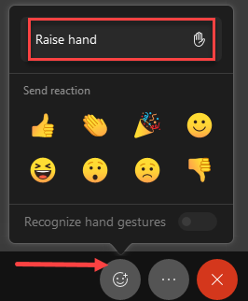
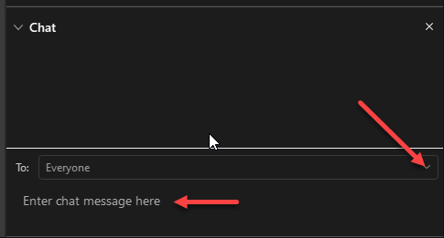
Welcome to [insert name of session]!
Raise Hand & React
Audio/Video
Chat
Click to unmute and start video when speaking.
Use the Chat panel for questions or comments.

Slide 2
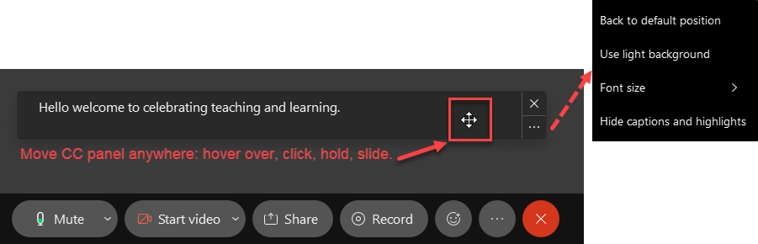
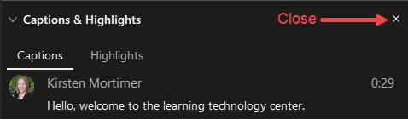

Customize Webex Assistant
Webex Assistant provides Closed Captioning and in-meeting transcripts.

