Slide 1
Performance Evaluations in Workday
October 2025
Presented by:
Human Resources

Slide 2
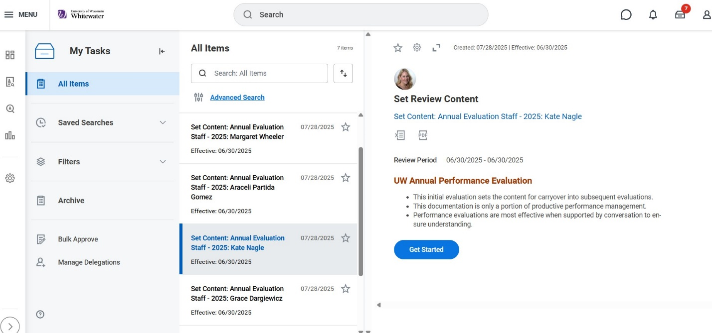
1. Manager will receive a task to Set Content for Annual Evaluation, Click ‘Get Started’ button.

Slide 3
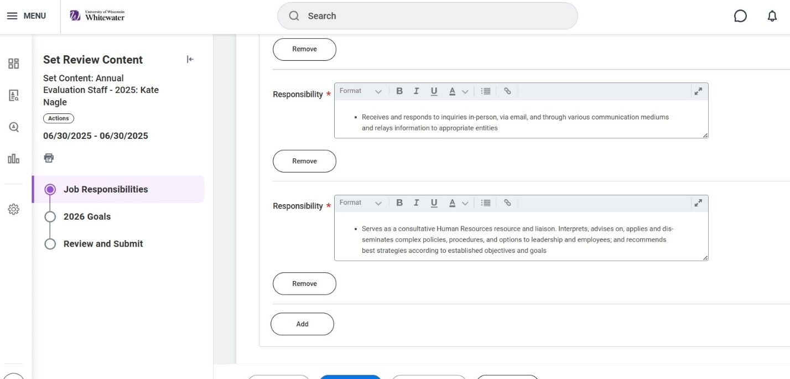
2. Job responsibilities will pull in from the Position Description. Check them over and click ‘Add’ button to add additional responsibilities. Once finished, click Submit.

Slide 4
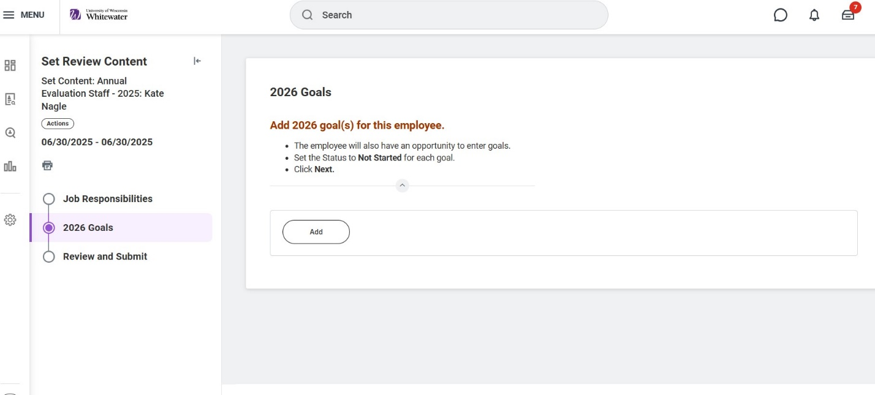
3. Set the goals. Add at least 3 goals. Enter the due date as the end of fiscal year and choose ‘In Progress’ as the status for each goal. Click next to review and submit. Once submitted, the employee will receive a task.

Slide 5
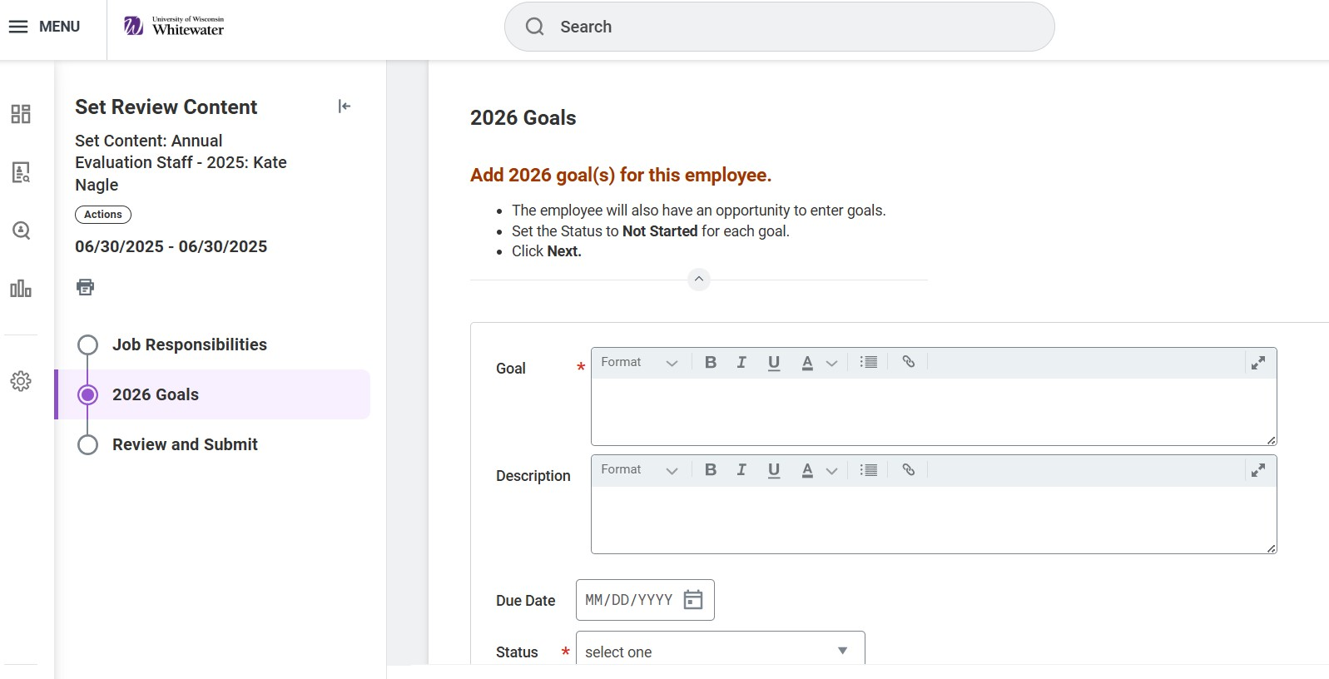
Goals Cont.

Slide 6
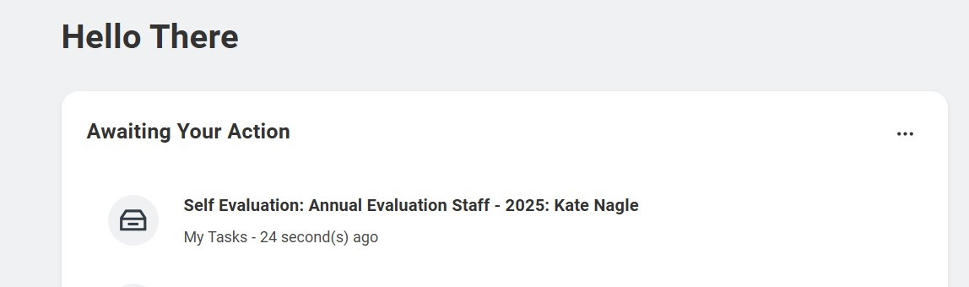
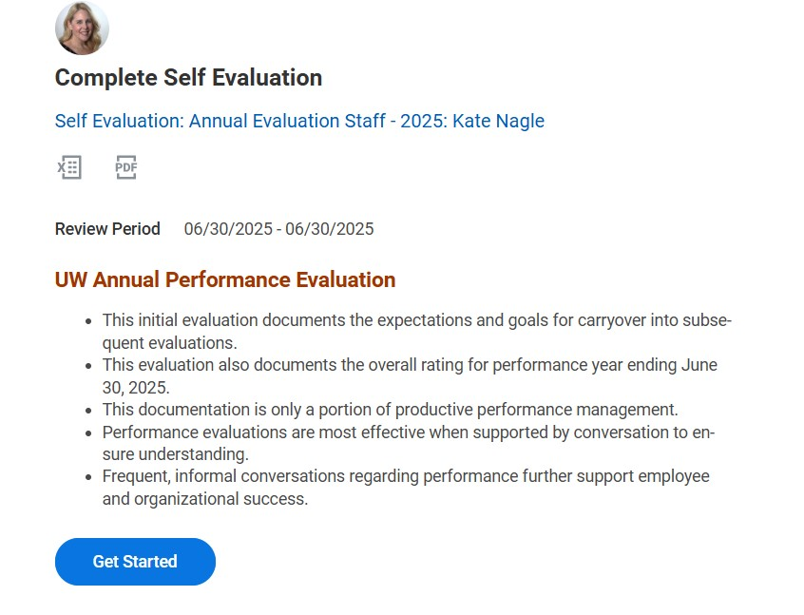
4. Employee will receive task to complete self-evaluation. Employee clicks ‘Get Started’, follow prompts and submits.

Slide 7
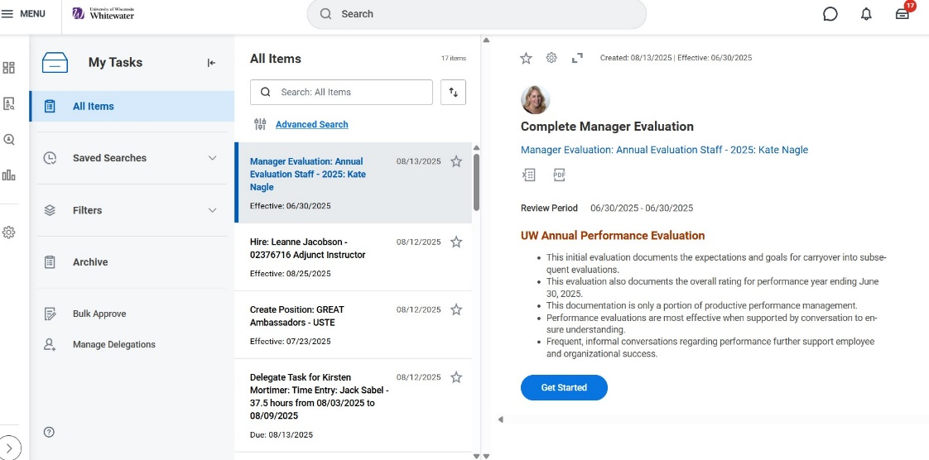
5. Manager get task to ‘Complete Manager Evaluation. Click ‘Get Started’ button, choose a rating for each responsibility, and click next.
Notes:
What to include

Slide 8
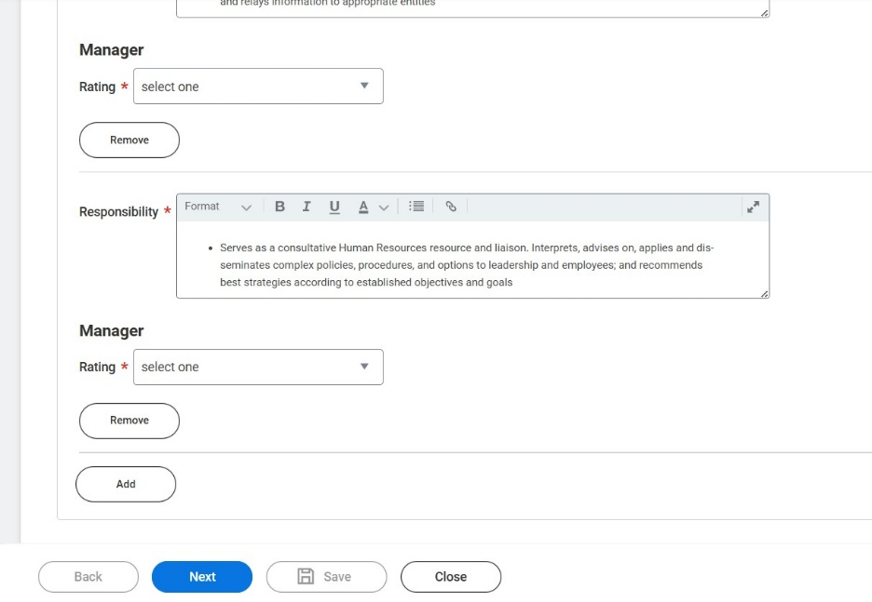
Rating Cont.

Slide 9
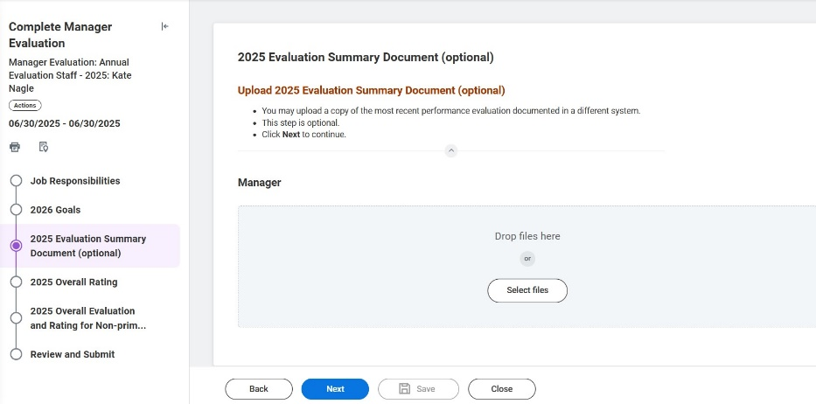
6. You have the option to attach an evaluation document. After, click next and choose an overall rating. Click next.

Slide 10
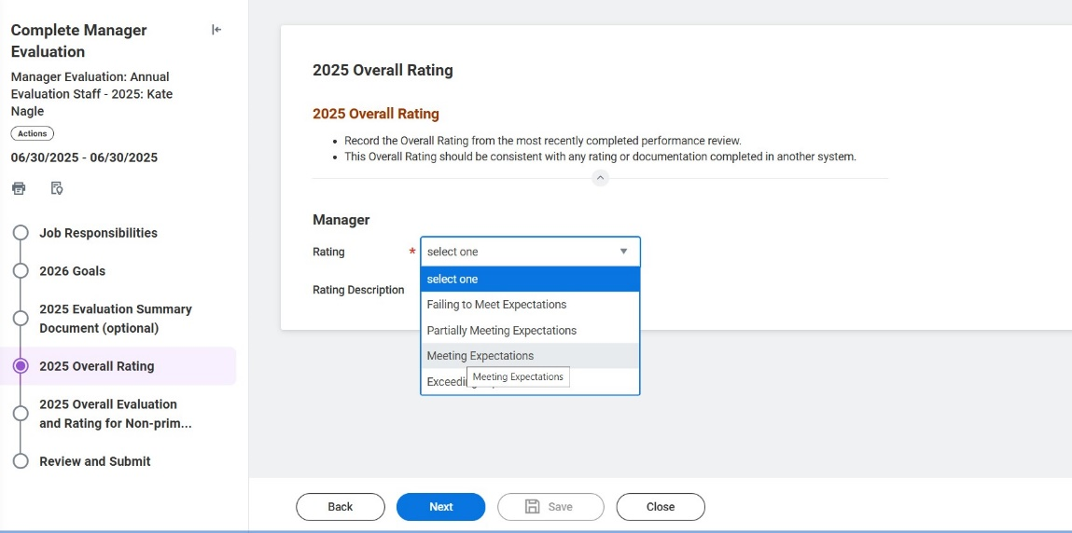
Rating Cont.

Slide 11
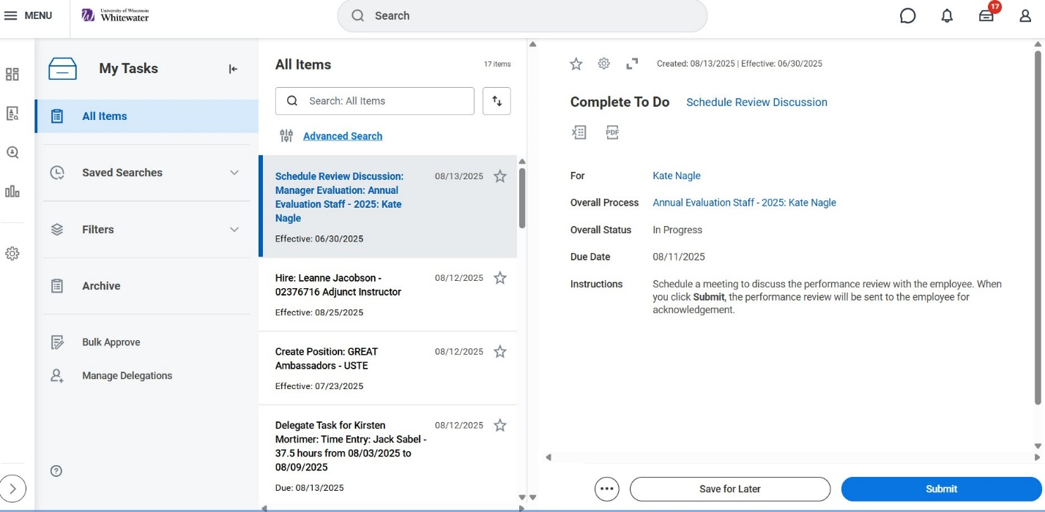
7. Manager will receive a task to schedule review discussion. Click Submit

Slide 12
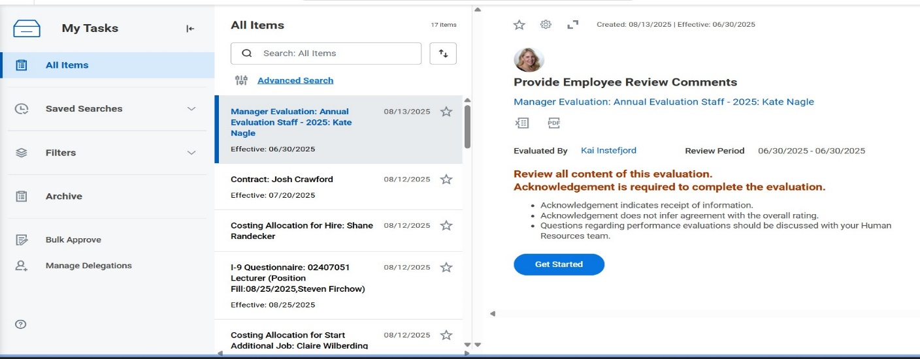
8. Employee will receive a task to ‘Provide review comments’. Employee clicks ‘Get Started’, goes through prompts and must acknowledge receipt of evaluation. Employee then click submit

Slide 13
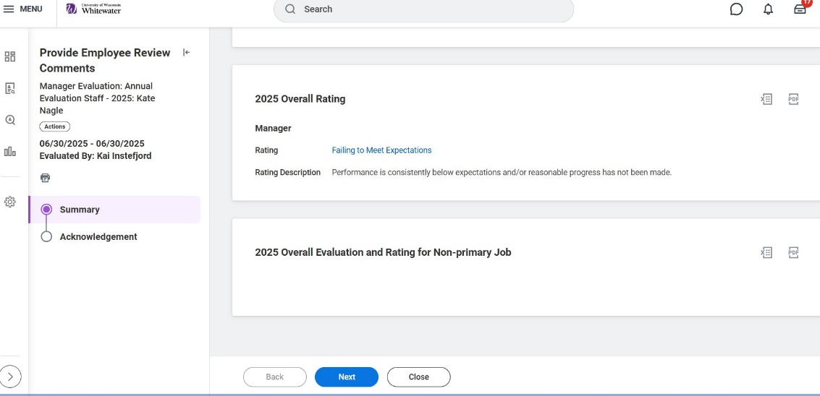
Employee comment Cont.

Slide 14
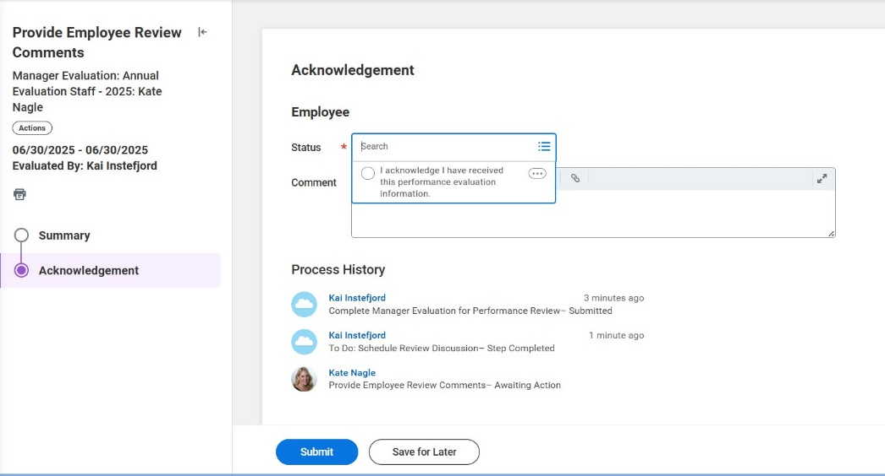
Employee comment cont.

Slide 15
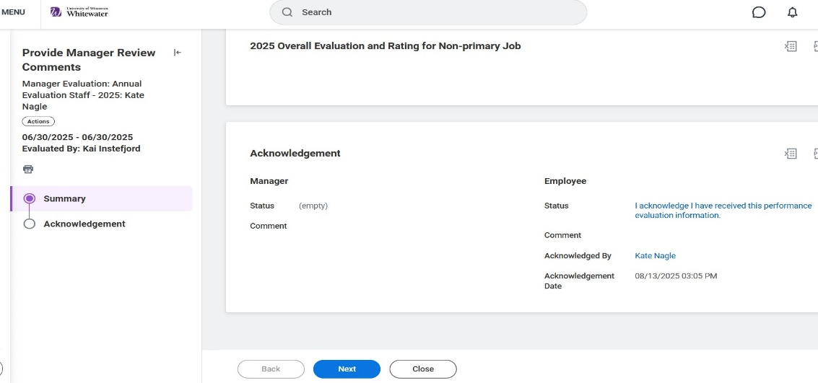
9. Manager recieves a task to acknowledge the evaluaution. Manager must acknowledge in the Status box and click submit.

Slide 16
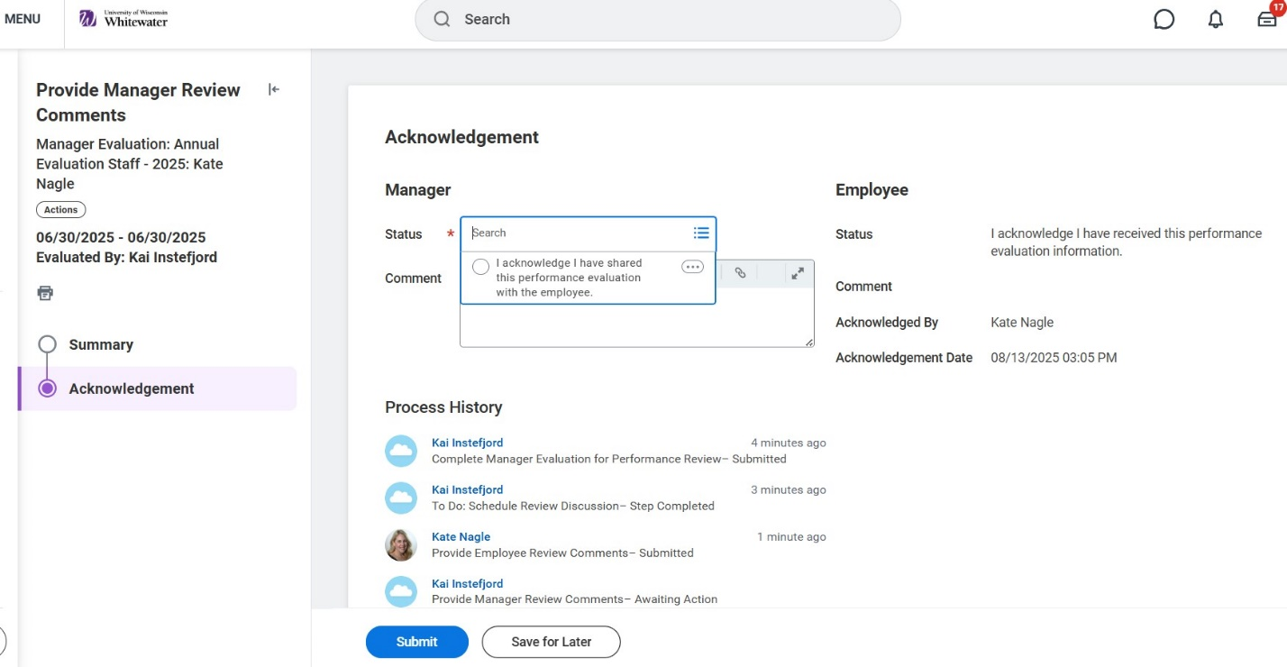
Manager acknowledgement Cont.

Slide 17
Questions

