Slide 1
E-Rehire
Human Resources
Talent Acquisition Team

Slide 2
Rehire Submission Timelines (NEW)
March 1st , 2024 – Spreadsheet with all current fixed terminal employees will be sent to deans/division heads, asking to indicate their intent to return for fall 2024.
April 1st , 2024 – Spreadsheets need to be returned to InstefjoKE08@uww.edu
April 1st , 2024 – E-Rehire must be submitted by this date for any employee indicated “Y” on the spreadsheet. Employee will receive notification when E-Rehire is submitted.
April 10th , 2024 – HR sends notifications to deans/division heads for those who were indicated “Y” but have not had an E-Rehire submitted for them.
April 15th , 2024 – Deadline for colleges to notify employees who are not intended to return.

Slide 3

How to Get there
Human Resources website
Click: Forms http://www.uww.edu/adminaffairs/hr/forms
Click: E-Rehire - Web Application

Slide 4
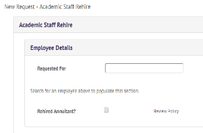
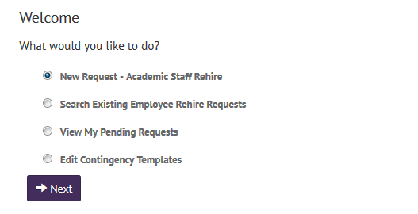
How To Get Started
Similar to “change of status”
  Find at Human Resources webpage under Change of Status
What are you requesting?
Click “New Request” then select rehire type
  Academic staff
  Academic staff dual contract
Choose new request when re-hiring an employee
This will be on the top of each tab. Fill in with employee name.
*Rehired Annuitant has a “review policy” link.
Notes:
You have the ease of searching for existing requests or viewing your pending requests
“Edit contingency Template” is for HR use
Once you click new request – you will have to choose if it is an academic staff rehire or academic staff dual contract
You can also search existing requests and look at your pending requests. This will help you see what stage they are at.
**Contingency Templates are already filled in (HR owns this)

Slide 5
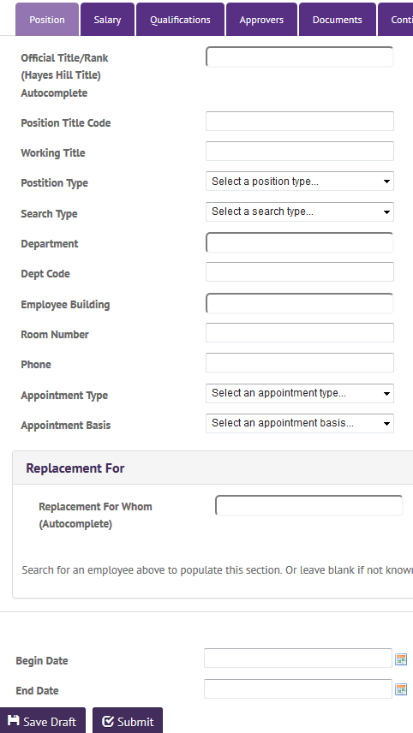
How To - Position
Similar to hire paperwork
Fill in all spaces
    Official Title/Rank (NEW PROCESS):
      >or= 50% FTE- Lecturer (TL020)
      <50% FTE- Adjunct Instructor (IC004)
    Working Title:
      > or = 50% FTE- Lecturer 1
      <50% FTE- Adjunct Instructor
    Position Type:
        Fixed Term
    If no room number/phone
      Use department’s
    Appointment Type
      Annual or academic
    Appointment Basis
      Full year, 1st Semester or 2nd
*Make sure everything is filled out*
Notes:
The next page looks like this. There are 6 tabs that need to be filled out. The first is position.
If there is no room number or telephone, just use the department’s
Fill in the rest as needed – almost identical to the paper form!
If replacement for whom is known – remember to fill that in
At the bottom of each tab you will see “begin date” and “end date” – this is where you put in the contract date. You can also save as a draft. When you click submit, it flows to the next approver.

Slide 6
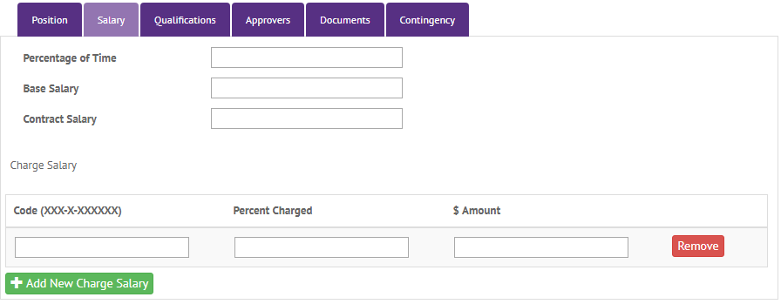
How To - Salary
Fill in Salary Information as seen below:
  Percentage of Time
    For Adjunct Instructor- Input “0”
    For Lecturers – Enter the FTE Percentage (no decimals)
  Base and Contract Salary
    For Adjunct Instructors – Base and Contract Salaries should be Entered as the Same Amount (the lump sum amount)
    For Lecturers – Enter the Base Salary and the Contract Salary Amounts
  Use green ‘add’ button to add
FTE
Notes:
Next tab is for salary information
Fill in all information

Slide 7
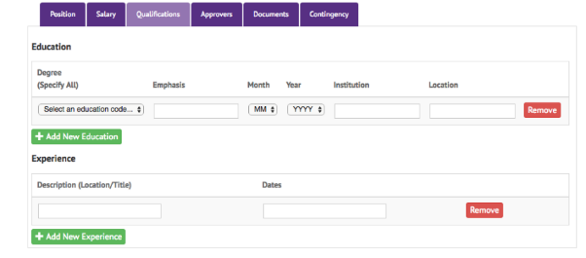
How To – Qualifications
Fill in all employee qualifications(refer to employee or original hire form if not known)
  Use green ‘add’ button to add more
  Chancellors office requests that these are added in and filled out
Notes:
This is very self explanatory, just fill in employees qualifications. You can find their qualifications on the original hire form or by asking the employee for updated qualifications.
Use the add button to add more experiences or degrees

Slide 8
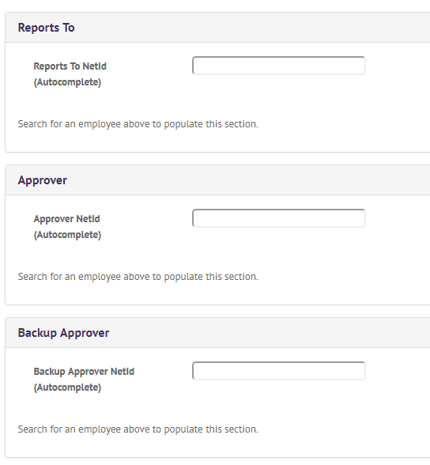
How to – approvers
Under Approvers Tab:
  This is for the individuals who approve the employees timesheet and time off requests
Search by NetId to add

Slide 9
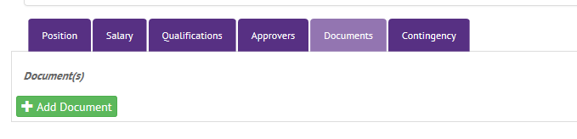
How to – documents
Documents must include
  Updated Employee Resume/CV (required by the Provost’s Office)
  Hiring Memo
Documents may include
  Position Description
  Any other relevant documents
Notes:
You can include any hiring documents in this page
*HR handles the contingency tab and will add in what is needed

Slide 10
After Submitting
After you click Submit – you will have to add in the correct individuals into the approval string. Approval flowchart is found on the E-Rehire Application Page
Employees who have two-department involvement requires sign-off by both departments. This may include Department Chairs, Deans, Directors, and Division Heads
For Academic Affairs: Provost office defers to Deans & Assistant Vice Chancellors: please do not insert Hermie Snorek or Provost into any approval strings
ALL Rehired Annuitants MUST go to Chancellor for approval
Notes:
- When you submit, you send to the next person in the approval string

Slide 11
Once approved
When fully approved
  HR will update system and send out rehire contract to employee
  Initiator and Department chair will be cc’ed on contract email
  It is department’s responsibility to keep track of rehires and submit them in a timely manner to ensure employee is rehired before start date

